Slide 1
Constrained motion on surfaces
Computational Physics I - PHYCS425
Authors:
Ali Merza Isa 20186917
Asif Bin Ayub 20191251
Kumail Abdulaziz 20196080

Slide 2
Table of contents
Introduction
Theory
1
2
Part I
Part II
3
4
Constrained motion
Runge-Kutta method (RK4)
Constrained motion in 1D
Constrained motion in 2D

Slide 3
1
Introduction
Constrained motion

Slide 4

Where can you see constrained motion?
Constrained motion is everywhere!
If you ever rode on a roller coaster, or tried ice skating, you know how frightening it can be. One way to overcome this fear is by studying constrained motion in more detail.

Slide 5
2
Theory
Runge-Kutta method (RK4)

Slide 6
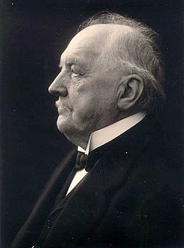
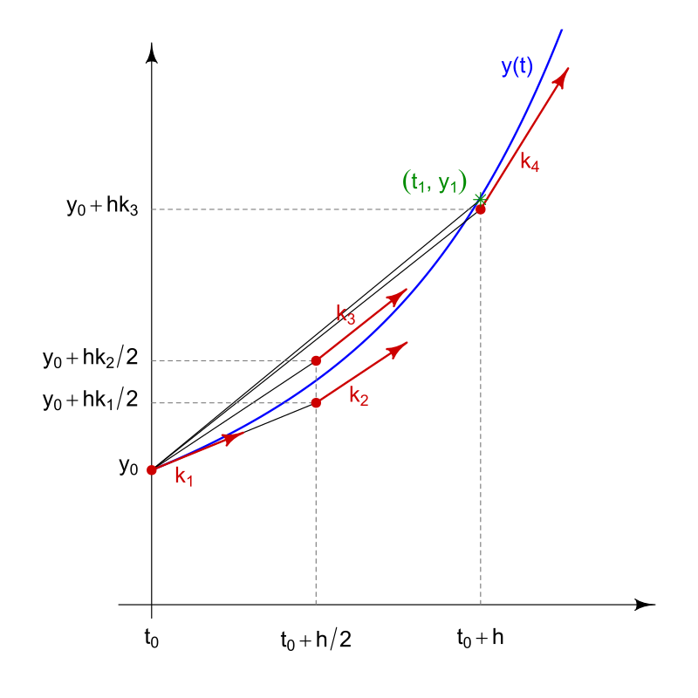
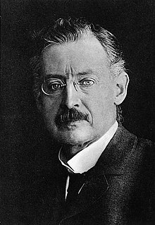

Runge-Kutta method (RK4)
A family of numerical methods developed by Carl Runge & Wilhelm Kutta around 1900.
RK4 scheme is an explicit method that has a local truncation error of $O\left(h^{5}\right)$, very accurate for simulations.
Preserves time reversal symmetry, leading to more accurate simulation of physical systems.

Slide 7
3
Part I
Constrained motion in 1D

Slide 8
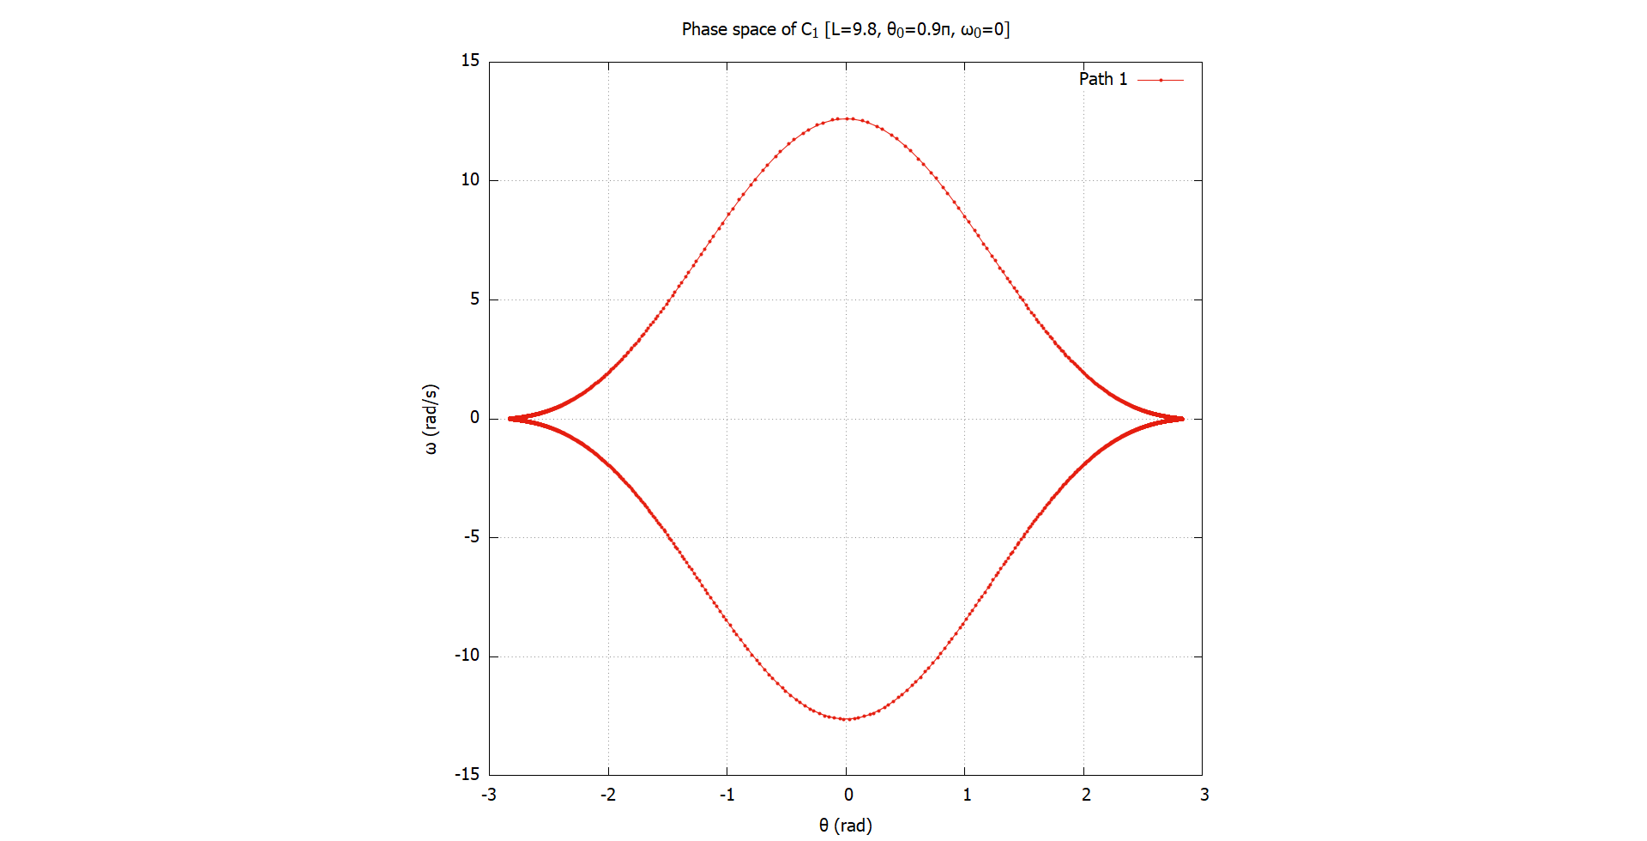
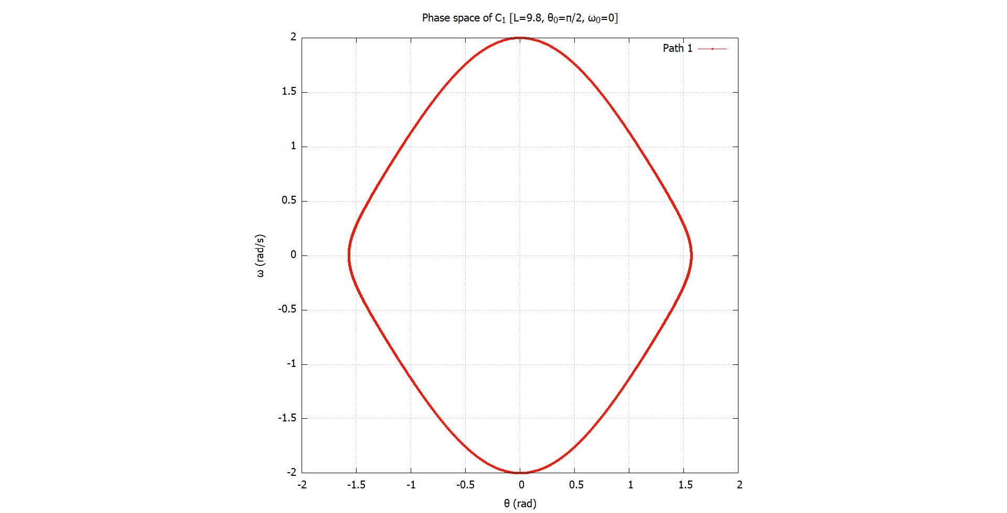


Curve $C_{1}$
Oscillatory motion and equilibrium points
The motion of $C_{1}$ is oscillatory for all initial conditions allowed by the system.
The phase portraits form a closed shape, indicating periodic motion.
Equilibrium point is at: $\left(0,−\frac{ℓ}{2}\right)$ or $θ=0$

Slide 9
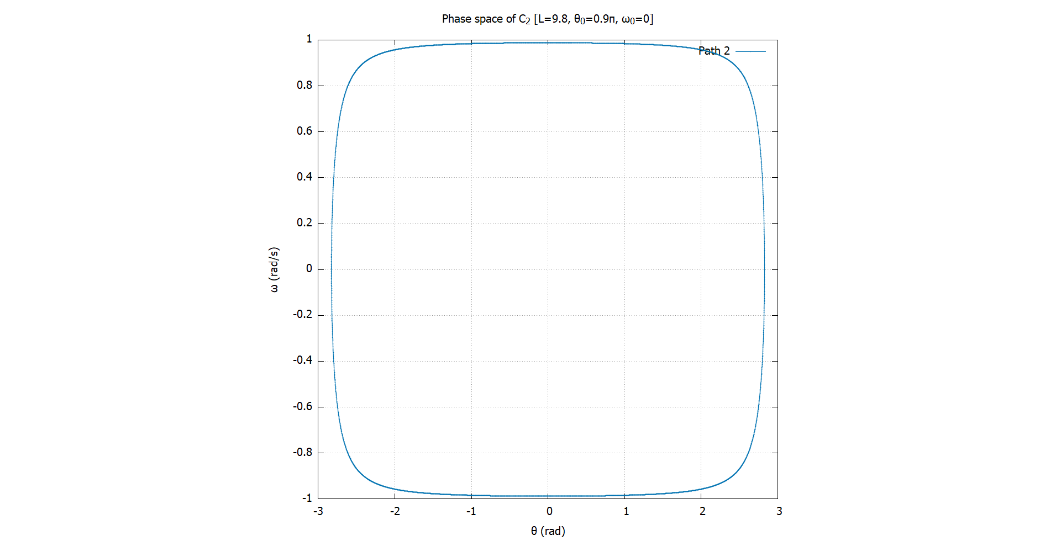
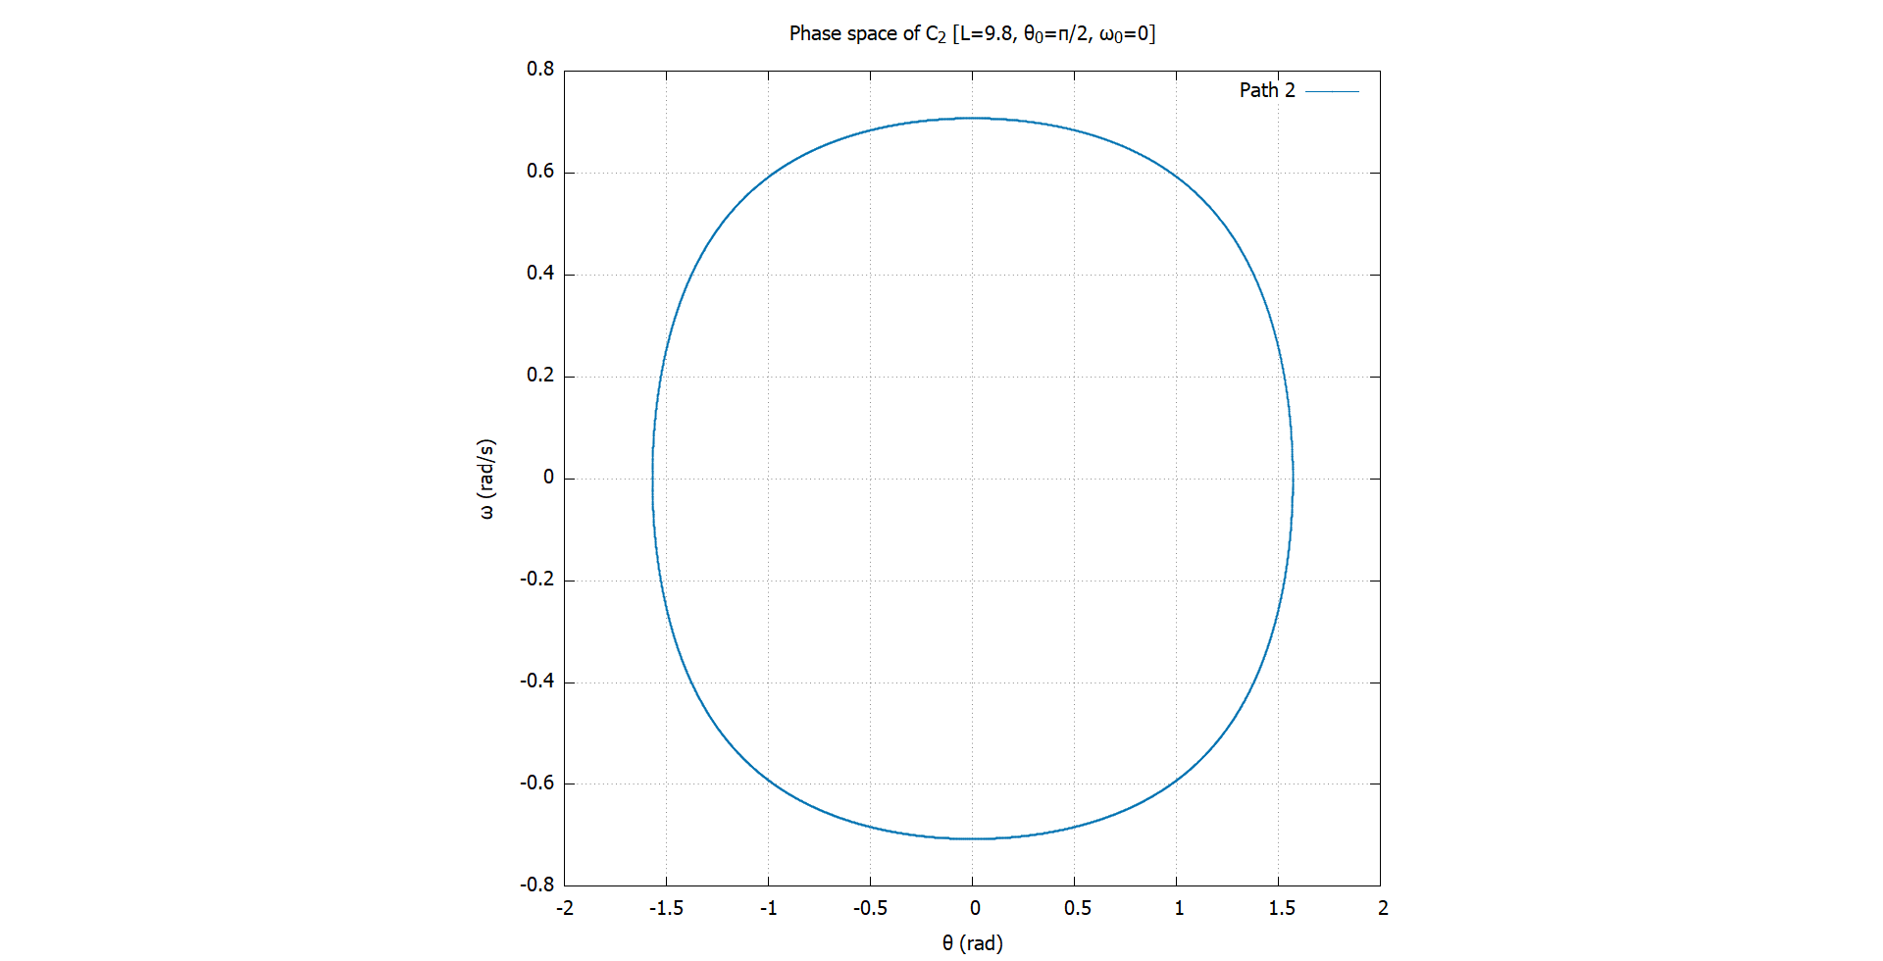


Curve $C_{2}$
Oscillatory motion and equilibrium points
Curve $C_{2}$ exhibits oscillatory motion, but not for all initial conditions.
If the initial velocity is too high, the particle can escape the curve.
Equilibrium point at: $\left(0,0\right)$ or $θ=0$

Slide 10
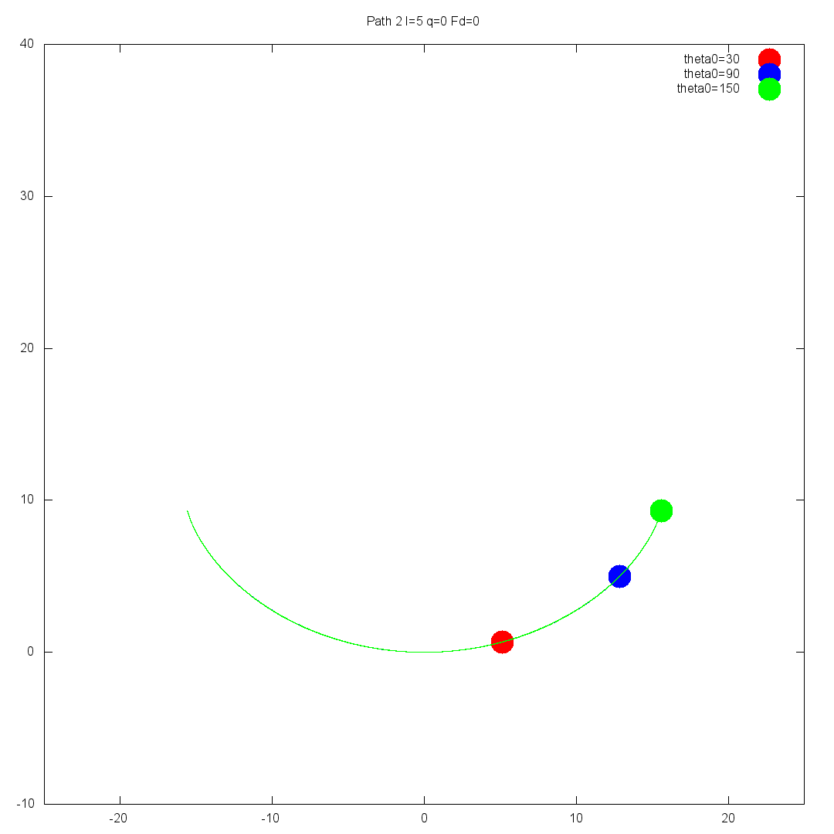
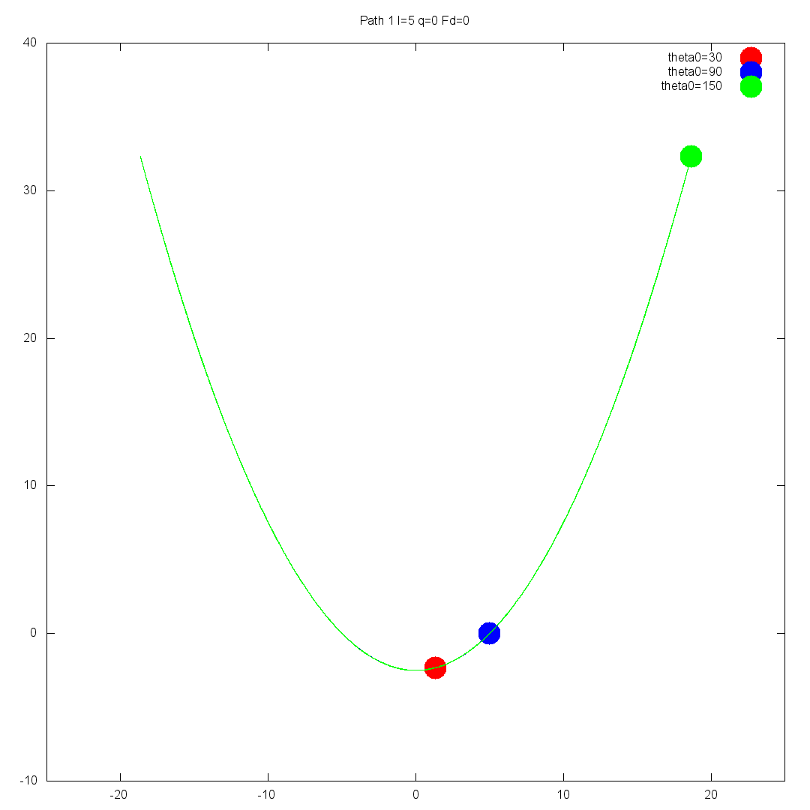
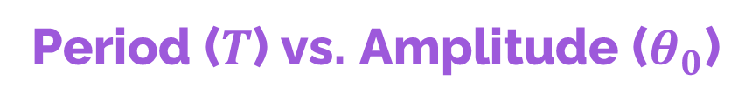
Period ($T$) vs. Amplitude ($θ_{0}$)
The period remains constant for $C_{2}$, but increases with $θ_{0}$ for $C_{1}$

Slide 11
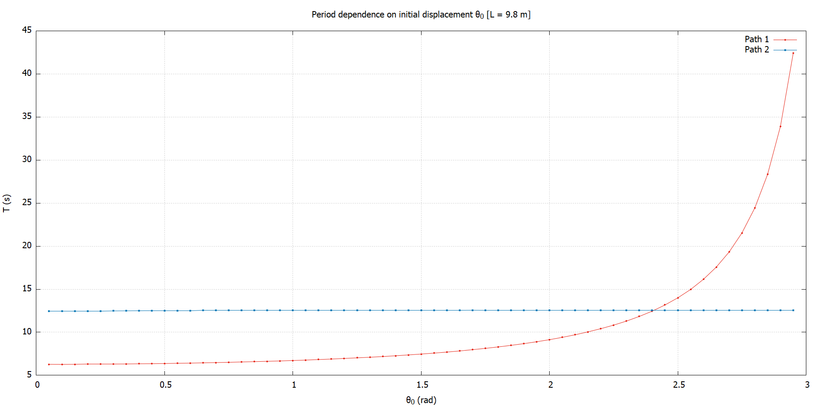


$$T(θ_{0},ℓ=g)$$
Period ($T$) vs. Amplitude ($θ_{0}$)
$$T_{1}≈\frac{2π}{\sqrt{1−\sin^{4}{\frac{θ_{0}}{2}}}}$$
$$T_{2}=4π$$

Slide 12
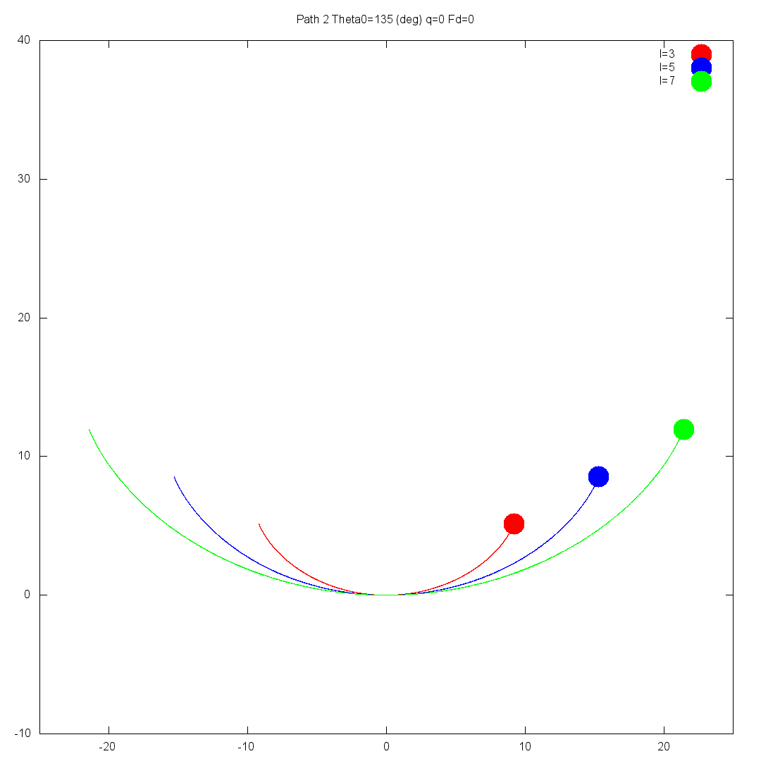
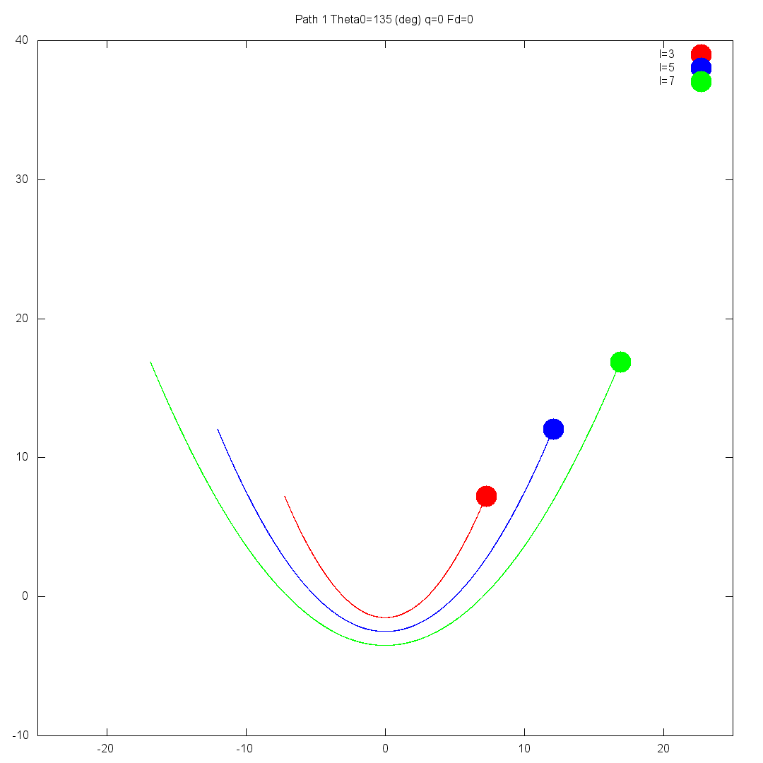
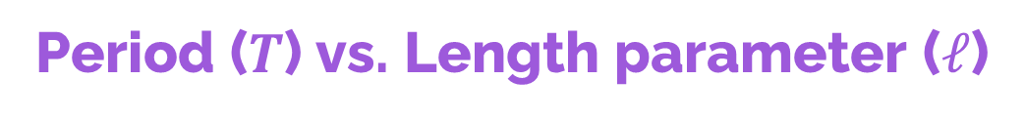
Period ($T$) vs. Length parameter ($ℓ$)
The period increases for both curves as we increase $ℓ$

Slide 13
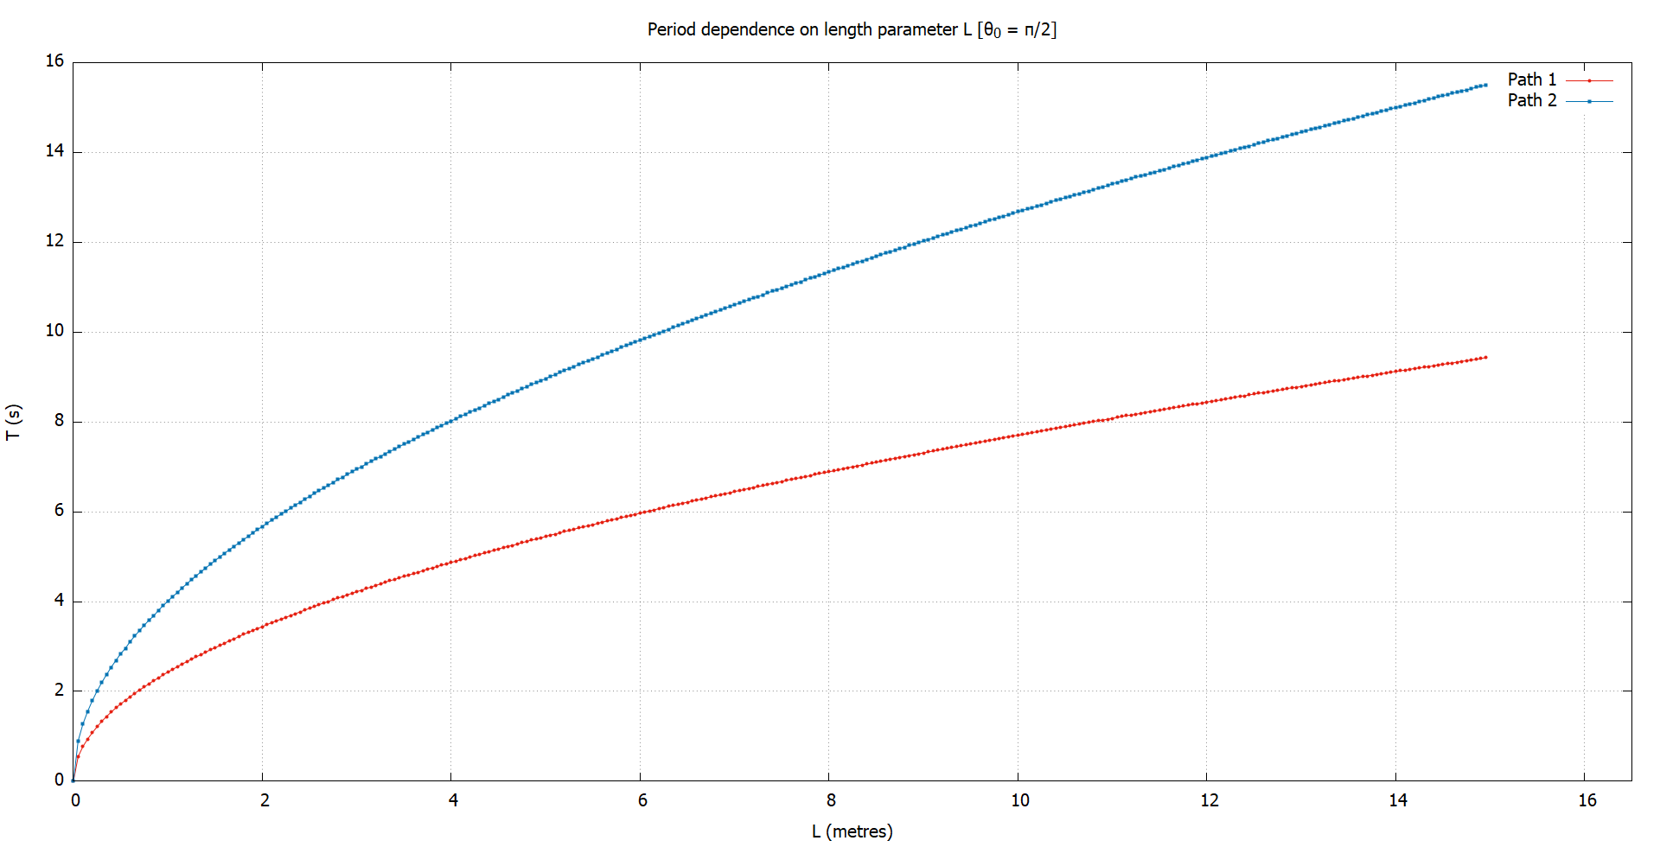


$$T\left(θ_{0}=\frac{π}{2},ℓ\right)$$
Period ($T$) vs. Length parameter ($ℓ$)
When we try to fit these curves, we find:
$$T_{1}∝\sqrt{ℓ}$$
$$T_{2}∝\sqrt{ℓ}$$

Slide 14







$$T(θ_{0},ℓ)$$
Period ($T$) as a function of ($ℓ$) and ($Ѳ$)
$$T_{1}≈\frac{2π\sqrt{ℓ/g}}{\sqrt{1−\sin^{4}{\frac{θ_{0}}{2}}}}$$
The expression for $C_{2}$ is quite accurate, and we think is exact.
$T_{1}$ is less accurate, giving a 3.36% error when compared to our data set.
Curve $C_{1}$
Curve $C_{2}$
$$T_{2}=4π\sqrt{\frac{ℓ}{g}}$$

Slide 15
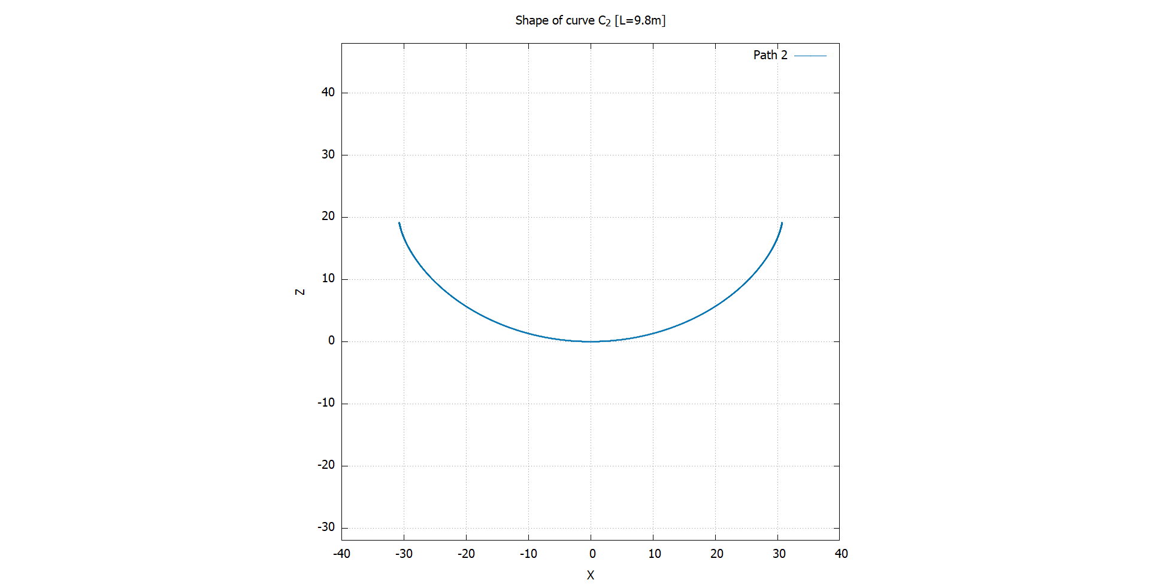
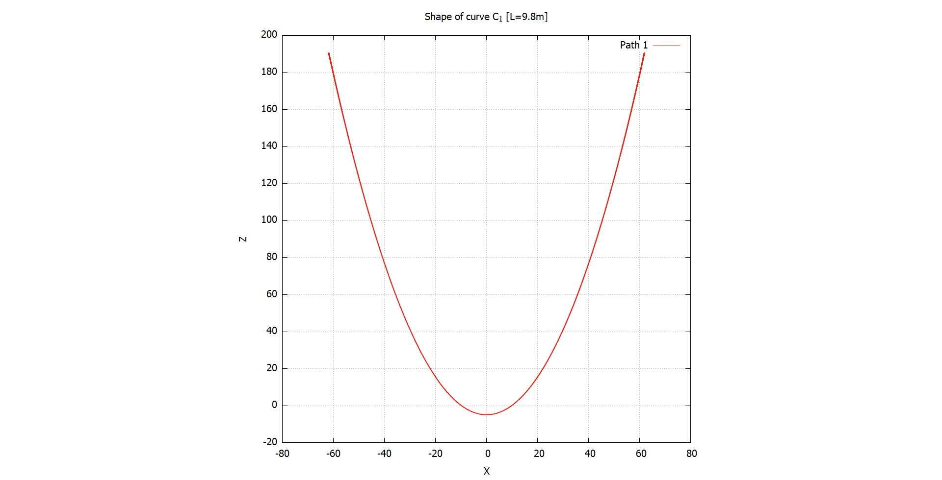
Identifying paths
$C_{2}$ is a cycloid. This was hinted at from our period analysis. Also, we derived the EoM.

Slide 16
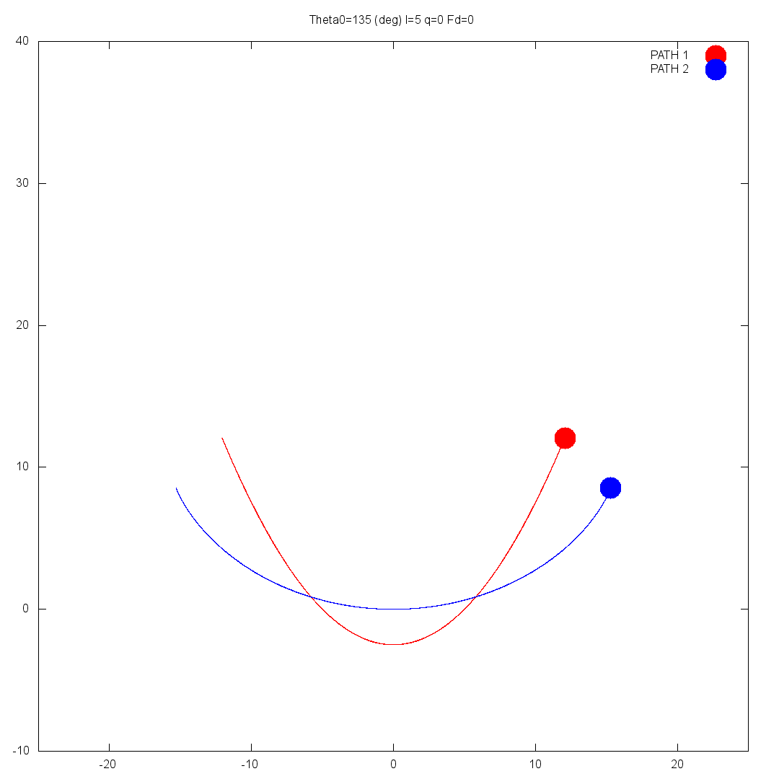

Identifying paths
Curve $C_{2}$ is a cycloid with parametric equation:
$$𝓵(θ+\sin{θ},1−\cos{θ})$$
Curve $C_{1}$ a parabola, which we were given.

Slide 17
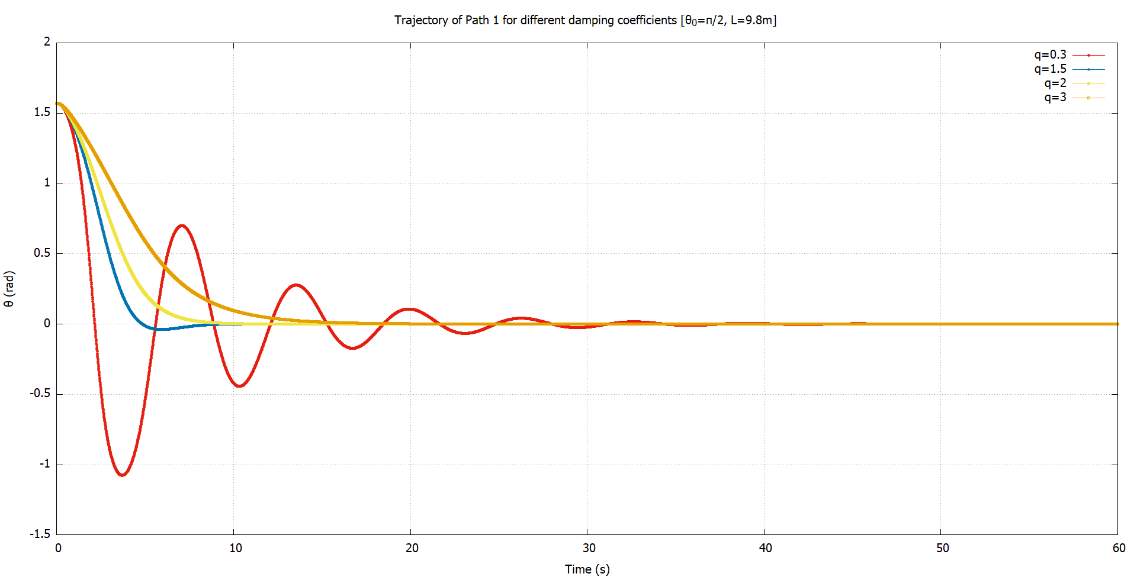


Damping ($C_{1}$)
Adding Damping & Driving Forces
A linear damping force was added: $F=−q\dot{θ}$
We observed underdamped, overdamped & critically damped motion.

Slide 18
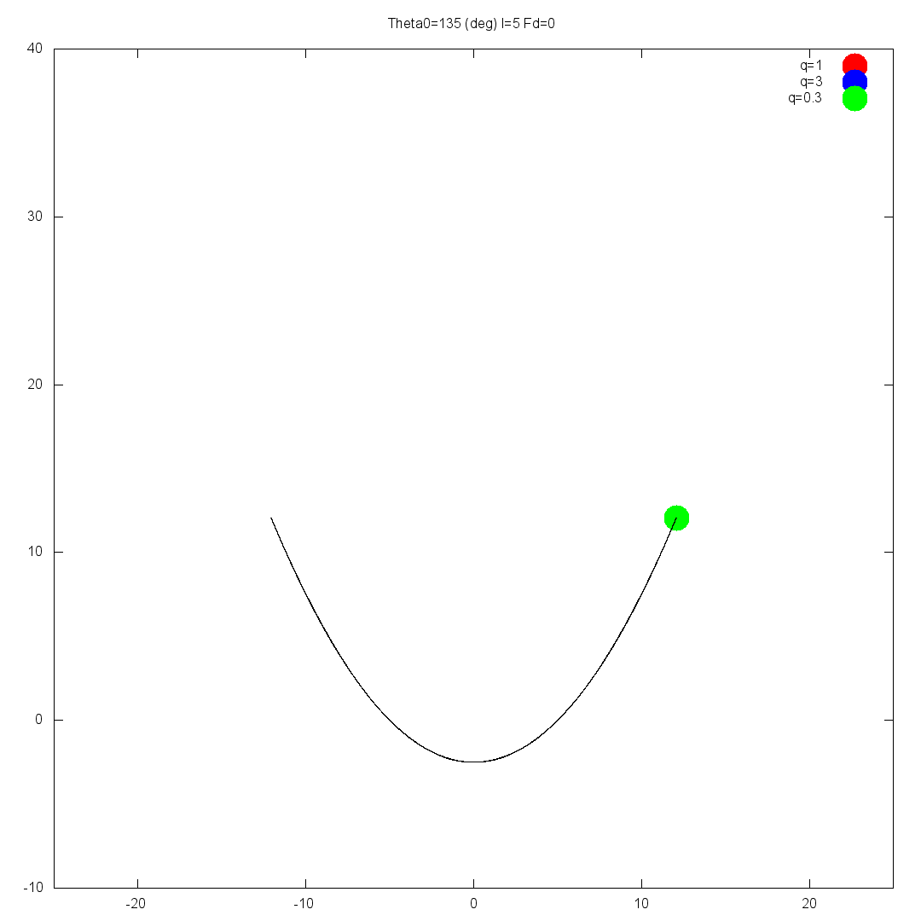

Damping ($C_{1}$)

Slide 19
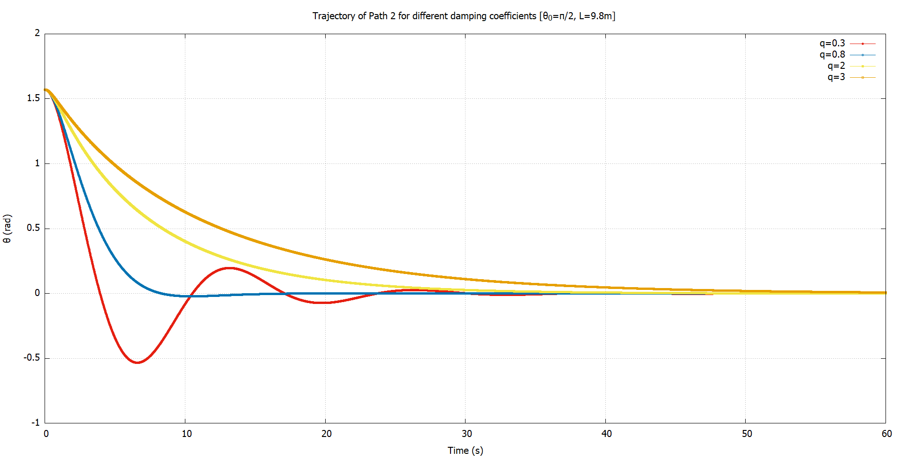


Damping ($C_{2}$)
Adding Damping & Driving Forces
The same results were obtained for $C_{2}$

Slide 20
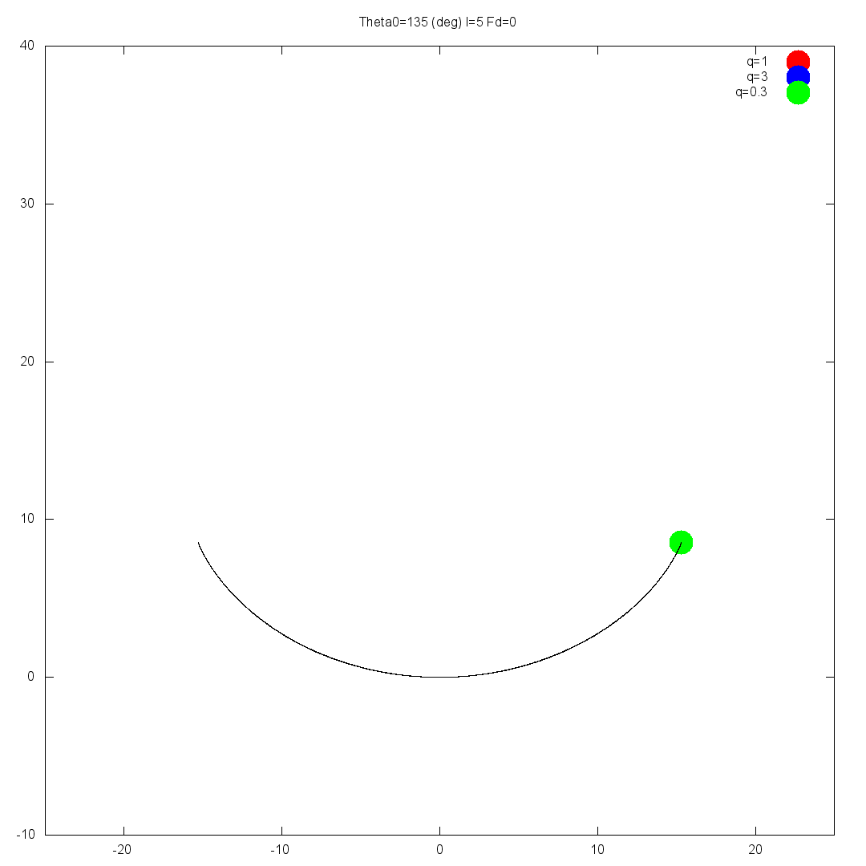

Damping ($C_{2}$)

Slide 21
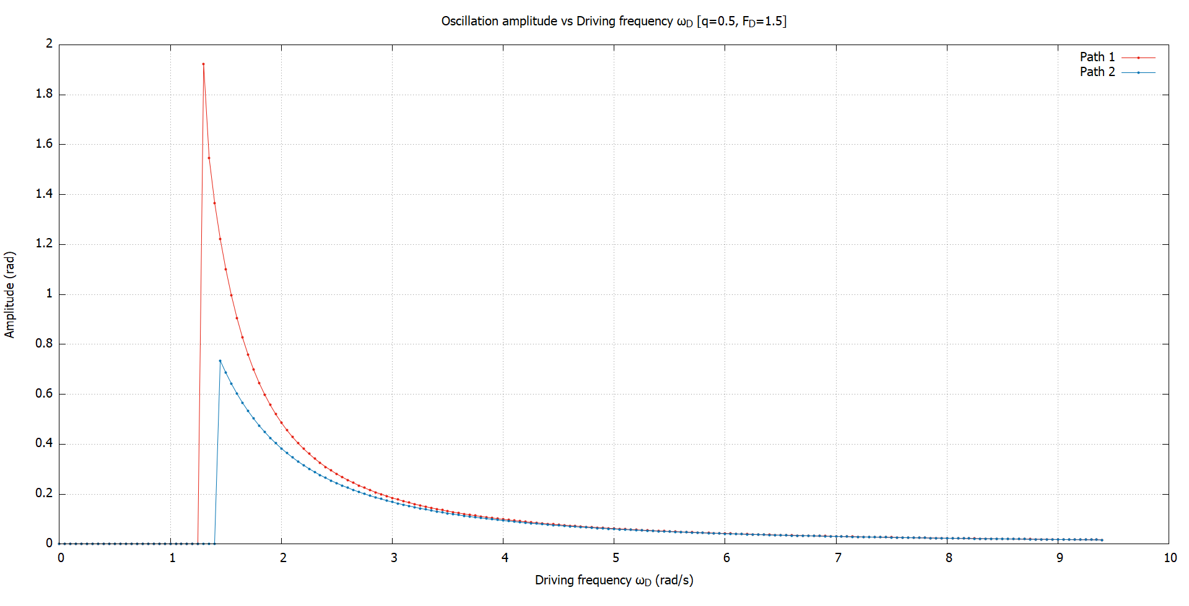

Driving frequency
(Where is) Chaos
The amplitude decreases with increasing $ω_{D}$.
At low frequencies, both curves blow up.
There is a resonance like behavior.

Slide 22
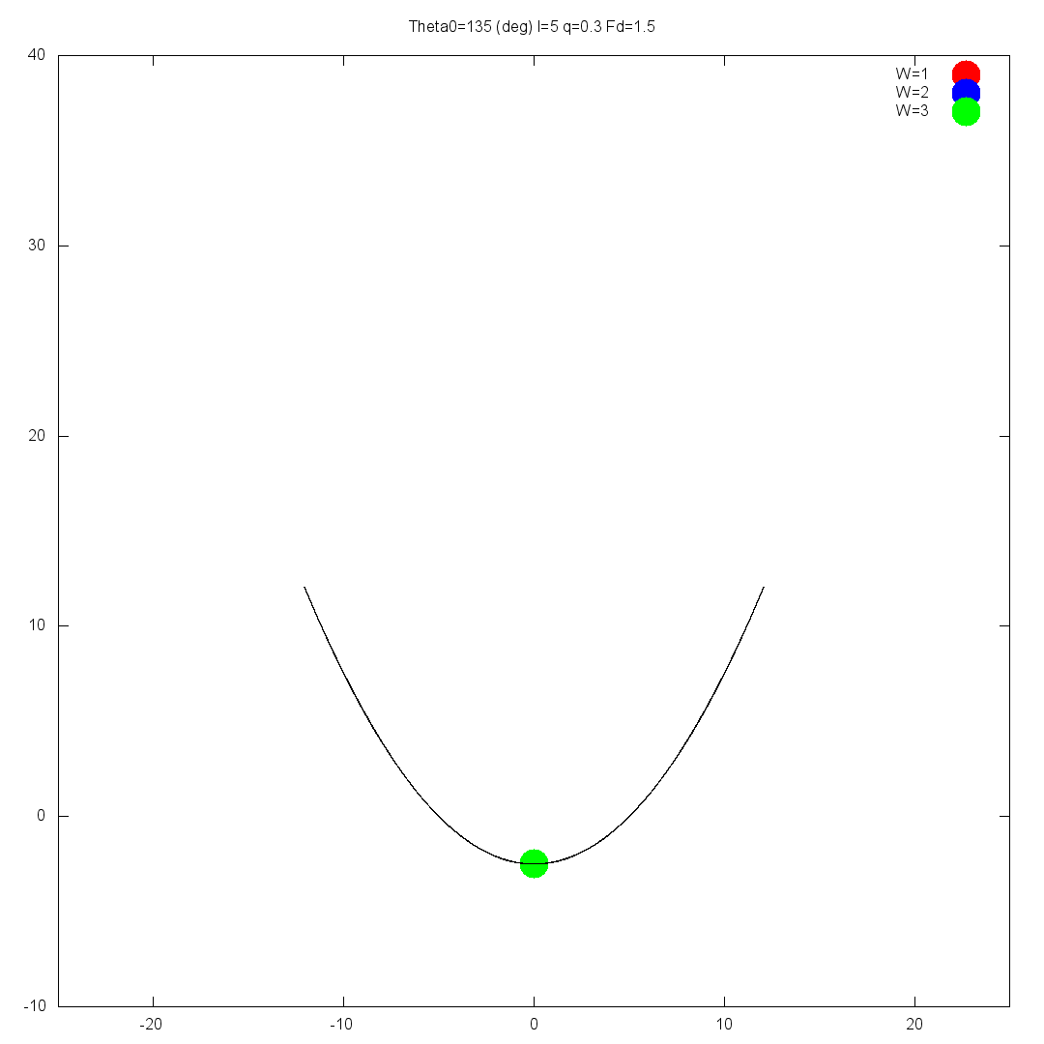
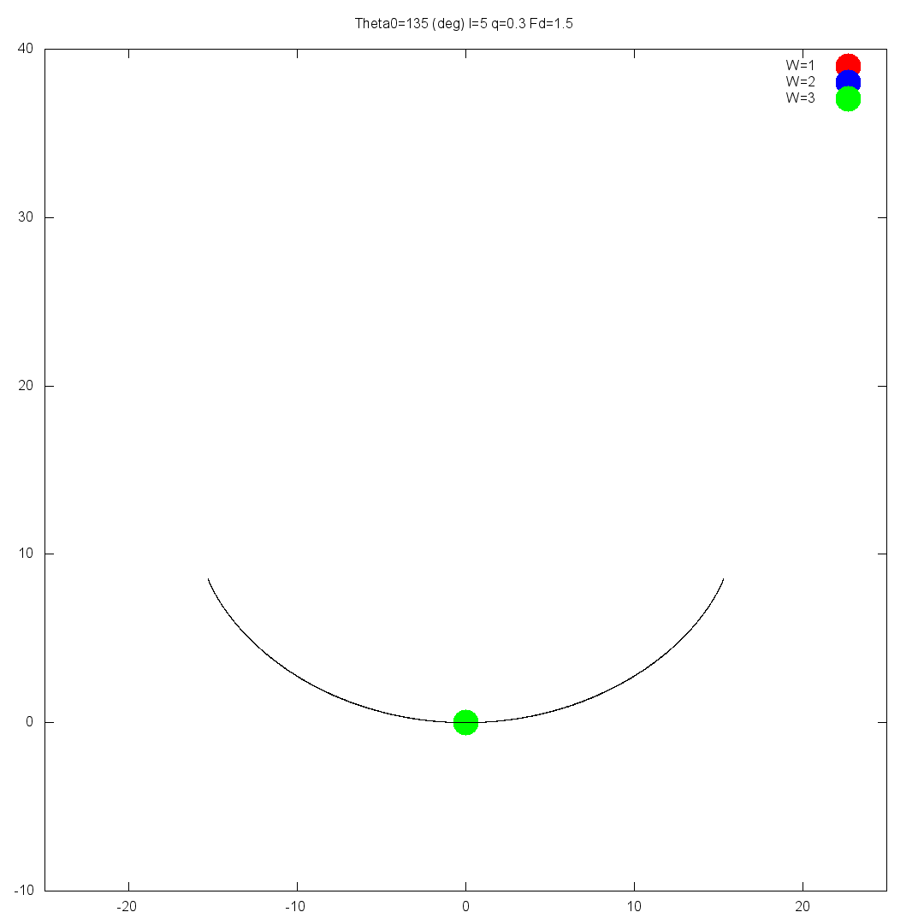
(Where is) Chaos
At low $ω_{D}$, both curves blow up.

Slide 23
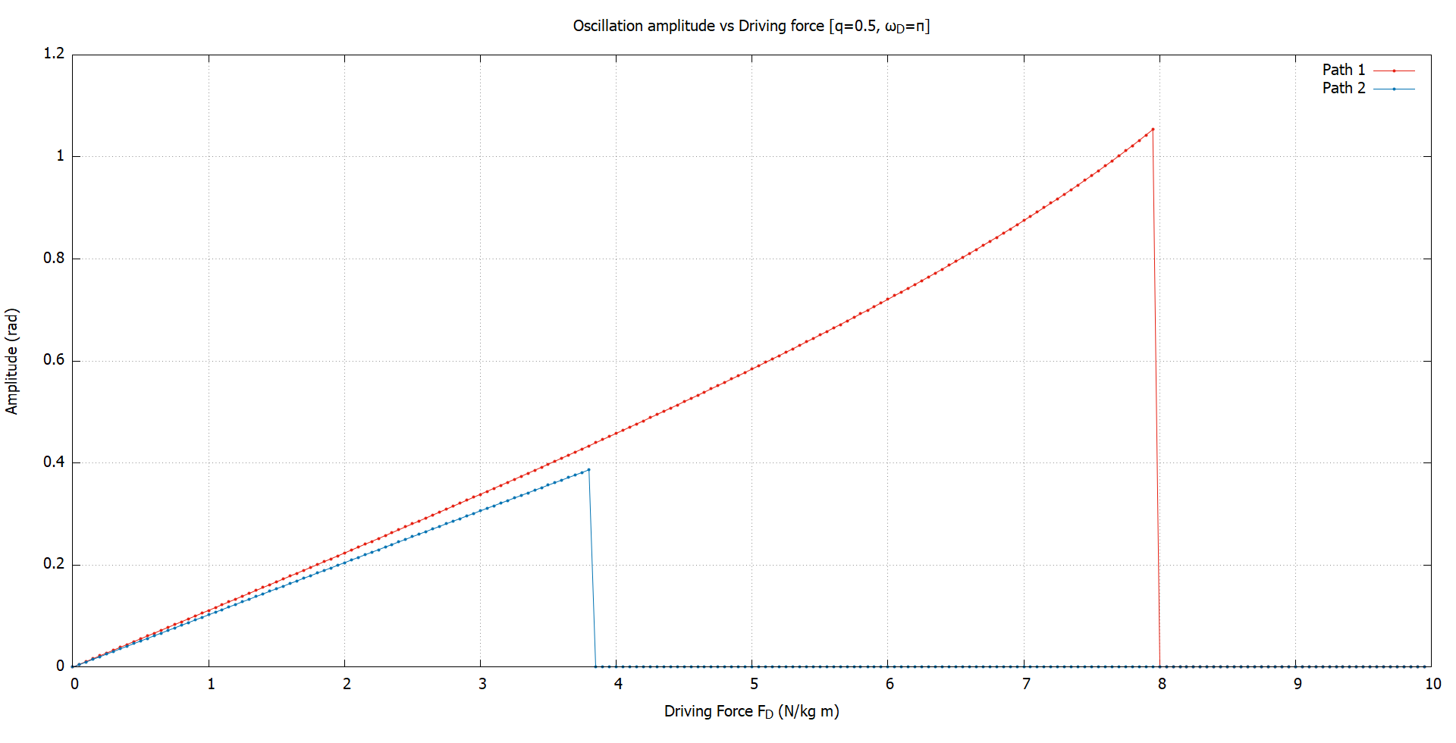

Driving Amplitude
(Where is) Chaos
As we increase $F_{D}$, the oscillation amplitude increases.
But it blows up if $F_{D}$ is very large.

Slide 24
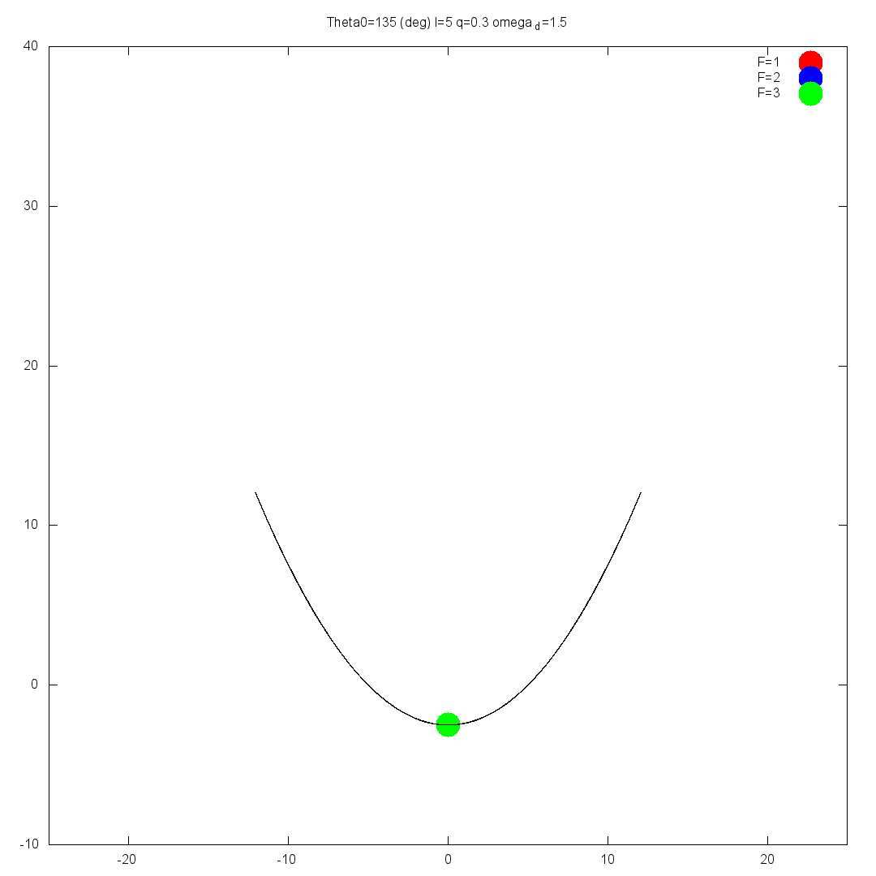
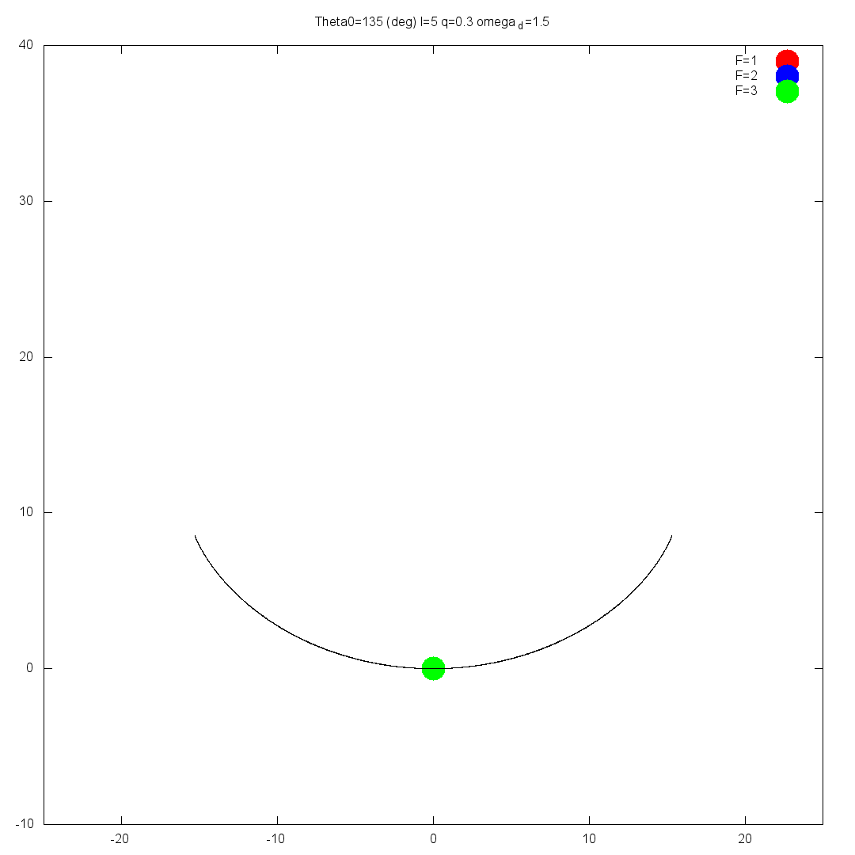
(Where is) Chaos
Increasing $F_{D}$ causes both curves to blow up

Slide 25

So, is there any chaos?
Some “period multiplied” trajectories were found for $C_{1}$, but not for the same $ω_{D}$.
As far as we know, there is no chaos, at least not through the period doubling route.
Needs more rigorous investigation using Lyapunov exponents.

Slide 26
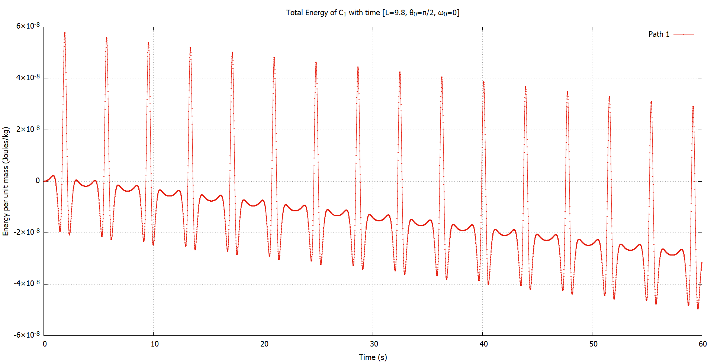

Curve $C_{1}$
Conservation of energy
For undamped, undriven system, the energy is almost constant.
So, energy is indeed conserved.

Slide 27
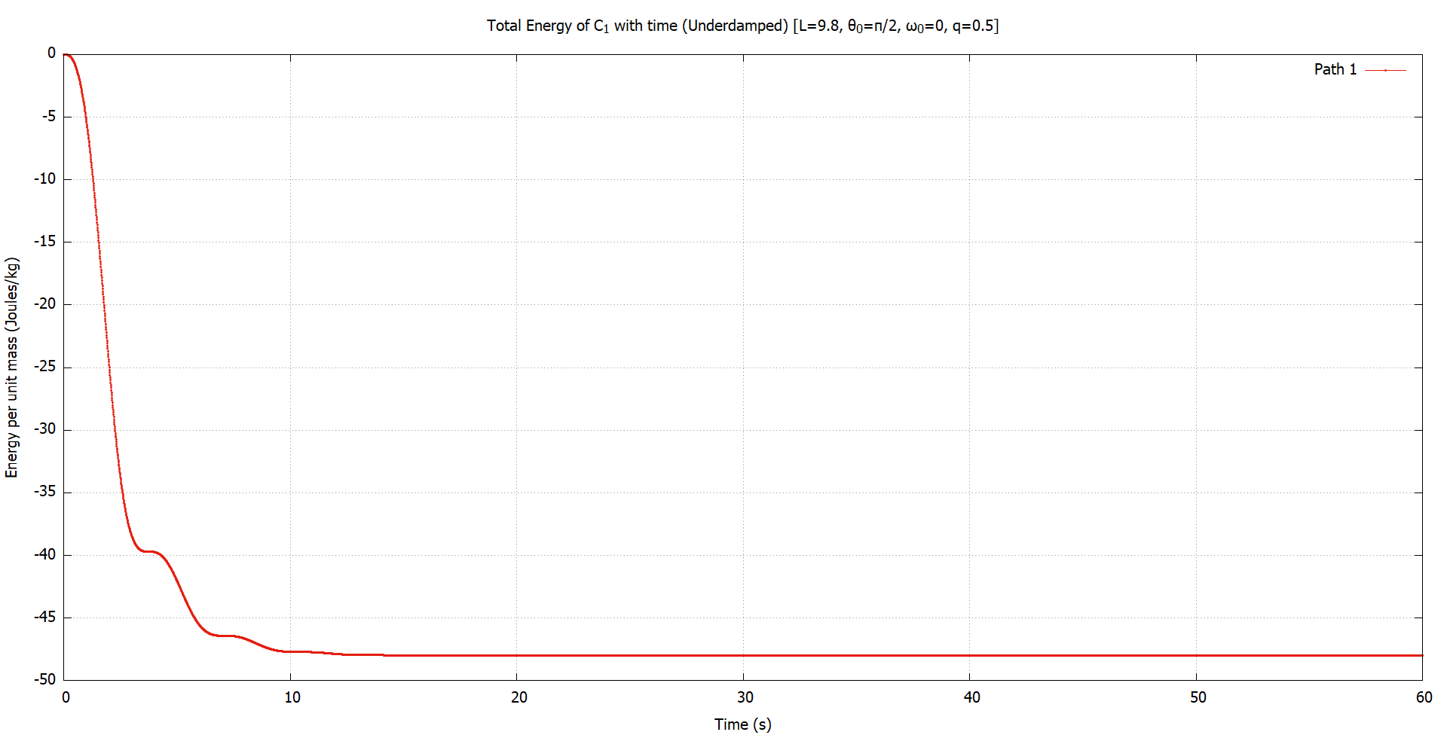

Damped ($C_{1}$)
Conservation of energy
When we add a slight damping force, the energy is quickly dissipated, which is the expected behavior.
Energy is negative because the equilibrium height is below 0.

Slide 28
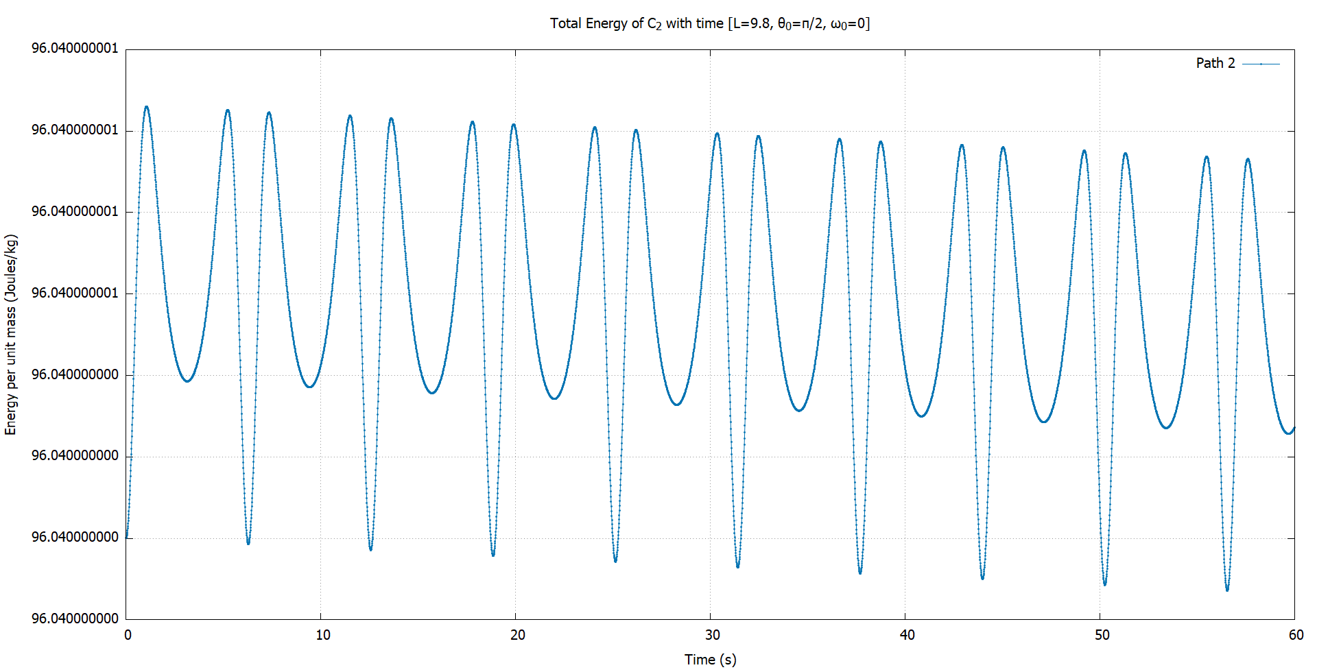


Curve $C_{2}$
Conservation of energy
In the absence of damping, energy is conserved for $C_{2}$ as well. The variation is very small and negligible.

Slide 29
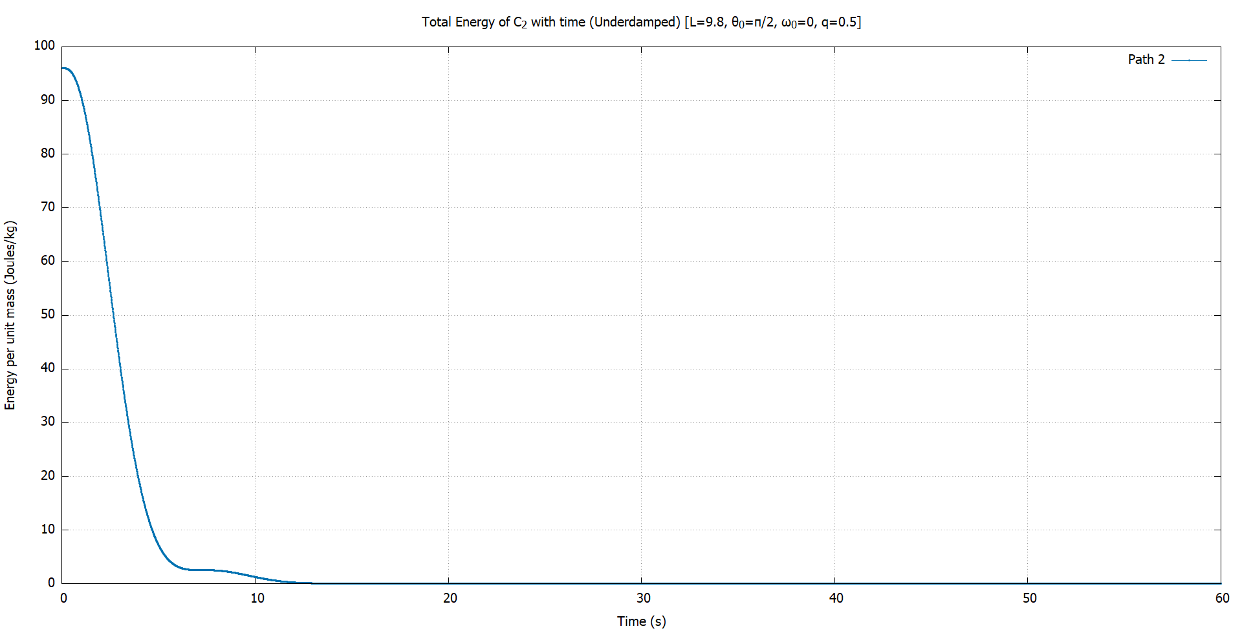


Damped ($C_{2}$)
Conservation of energy
Similar to $C_{1}$, the energy is quickly dissipated, reaching 0, corresponding to the equilibrium point.

Slide 30
4
Part II
Constrained motion in 2D

Slide 31
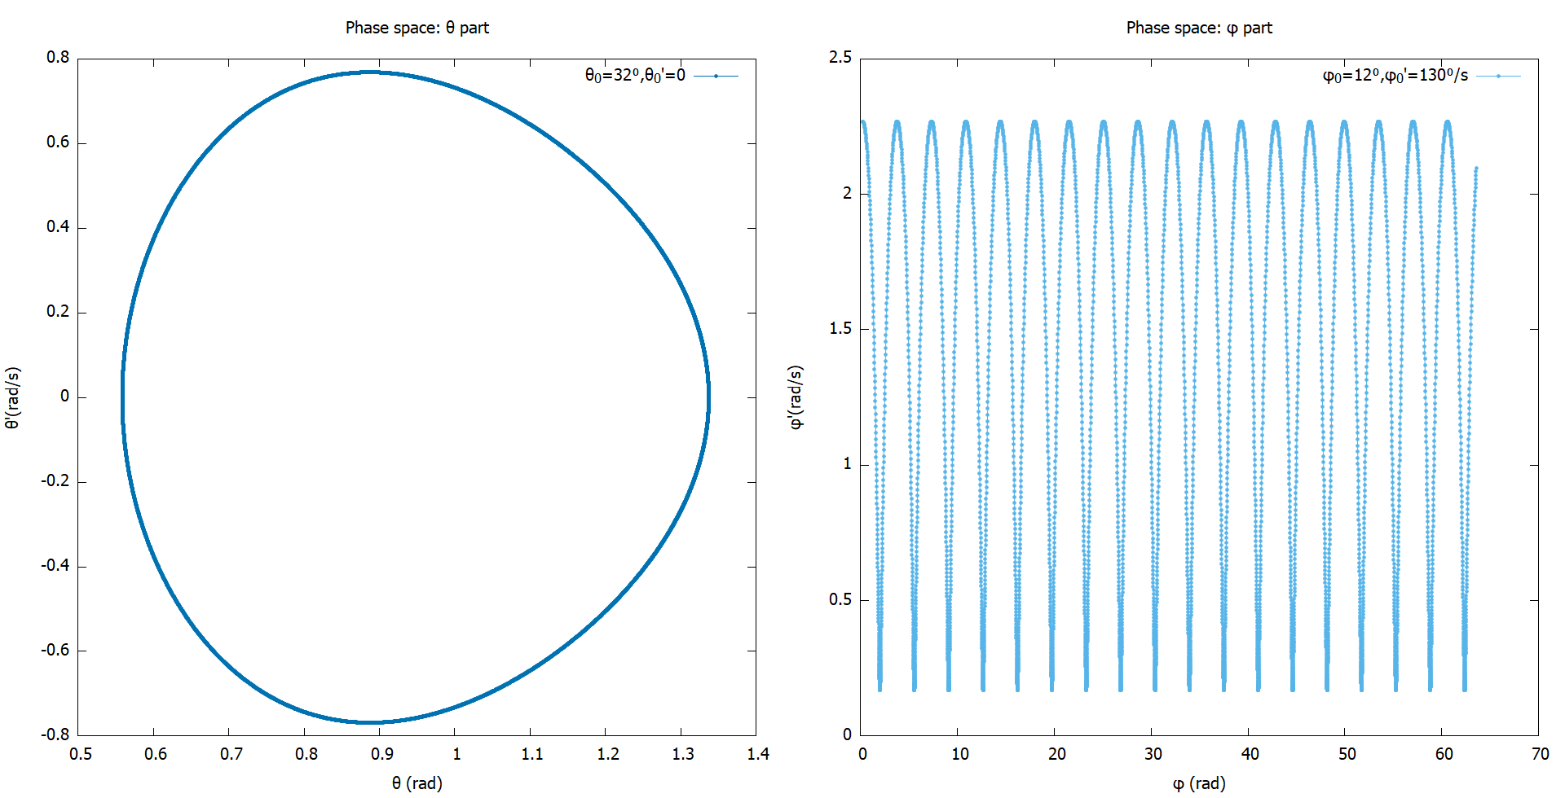

Phase space
Oscillatory motion
Motion in $θ$ is oscillatory. Along φ, it is periodic, but is not restricted to $[0,2π]$
The system blows up if initial angular velocities are too high.
Odd behavior when $θ>90⁰$

Slide 32
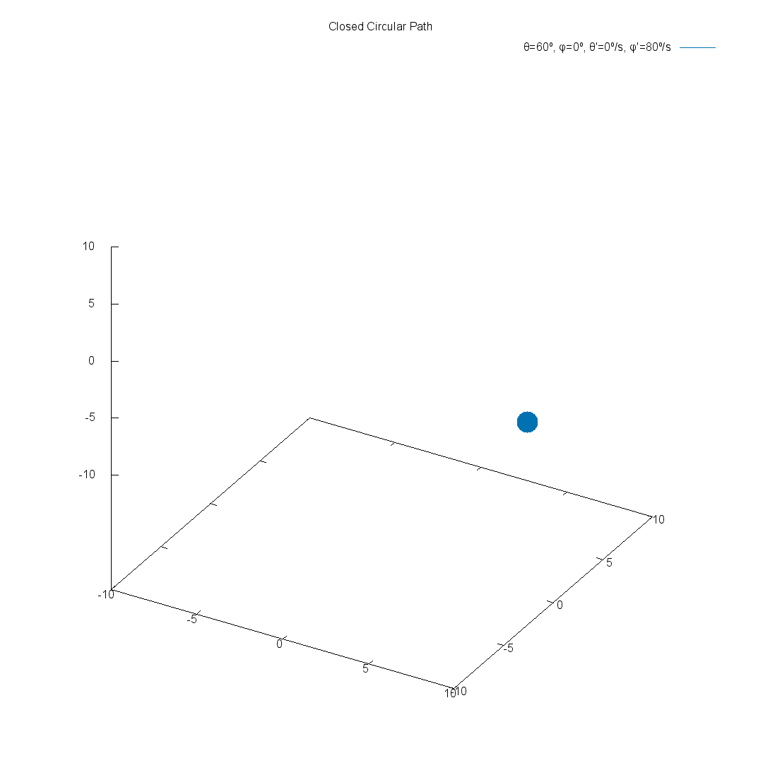
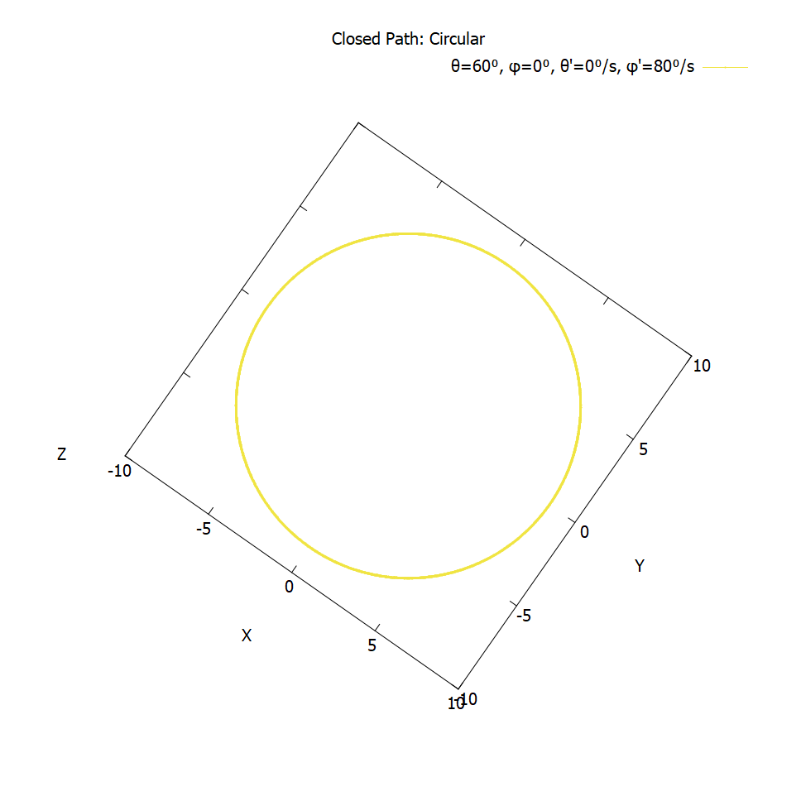
Closed paths
These are closed circular paths.

Slide 33
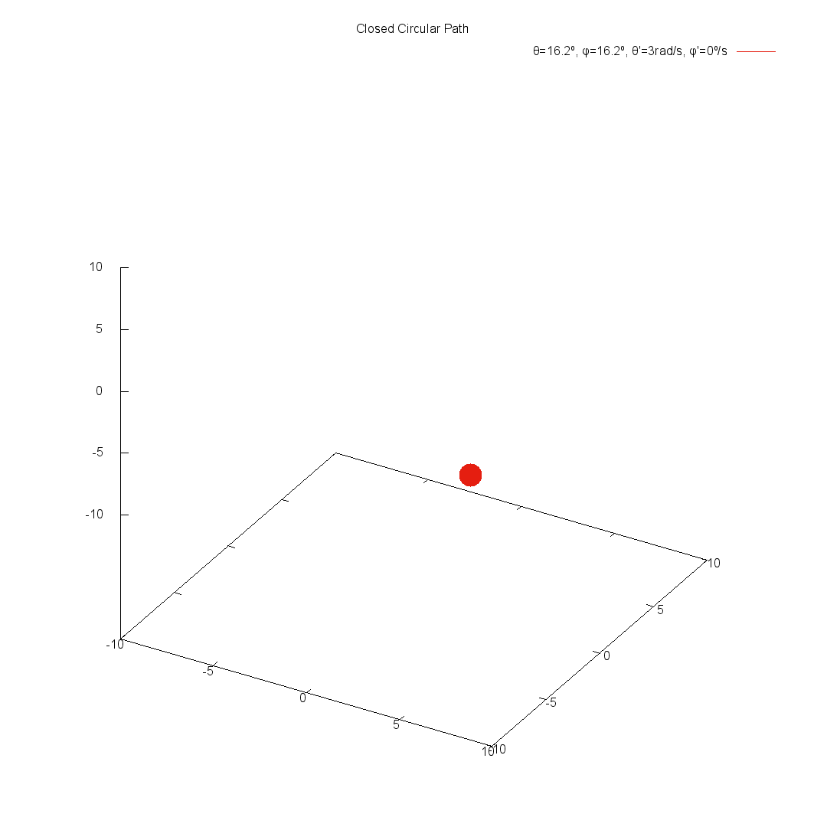
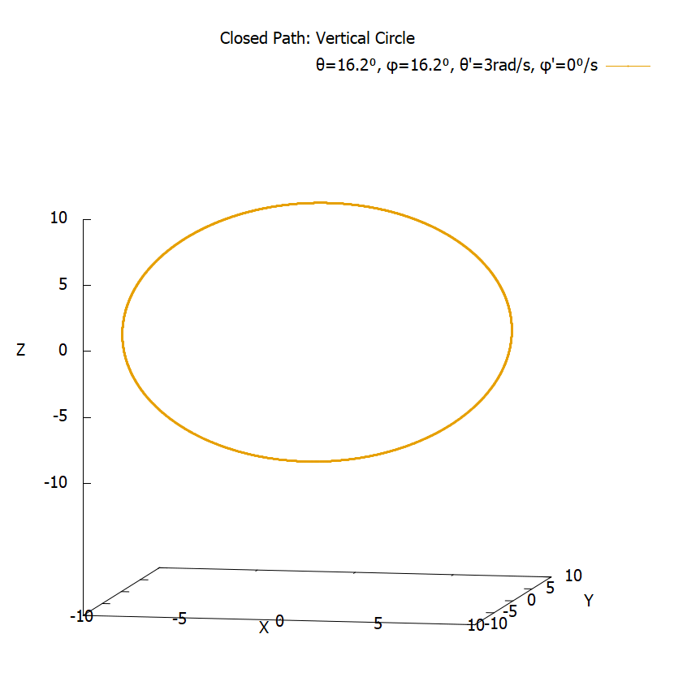
Closed paths
These paths also show that simple pendulum motion can be recreated on spherical surface.

Slide 34
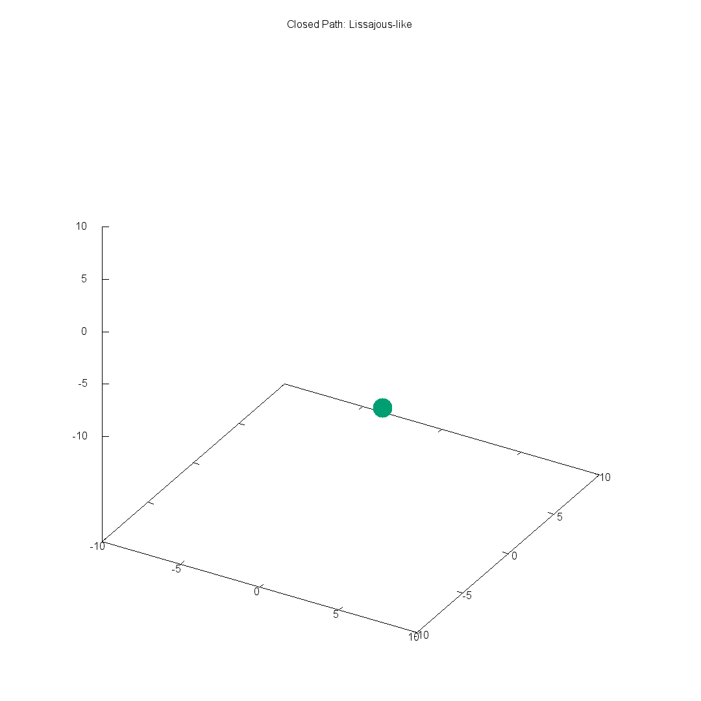
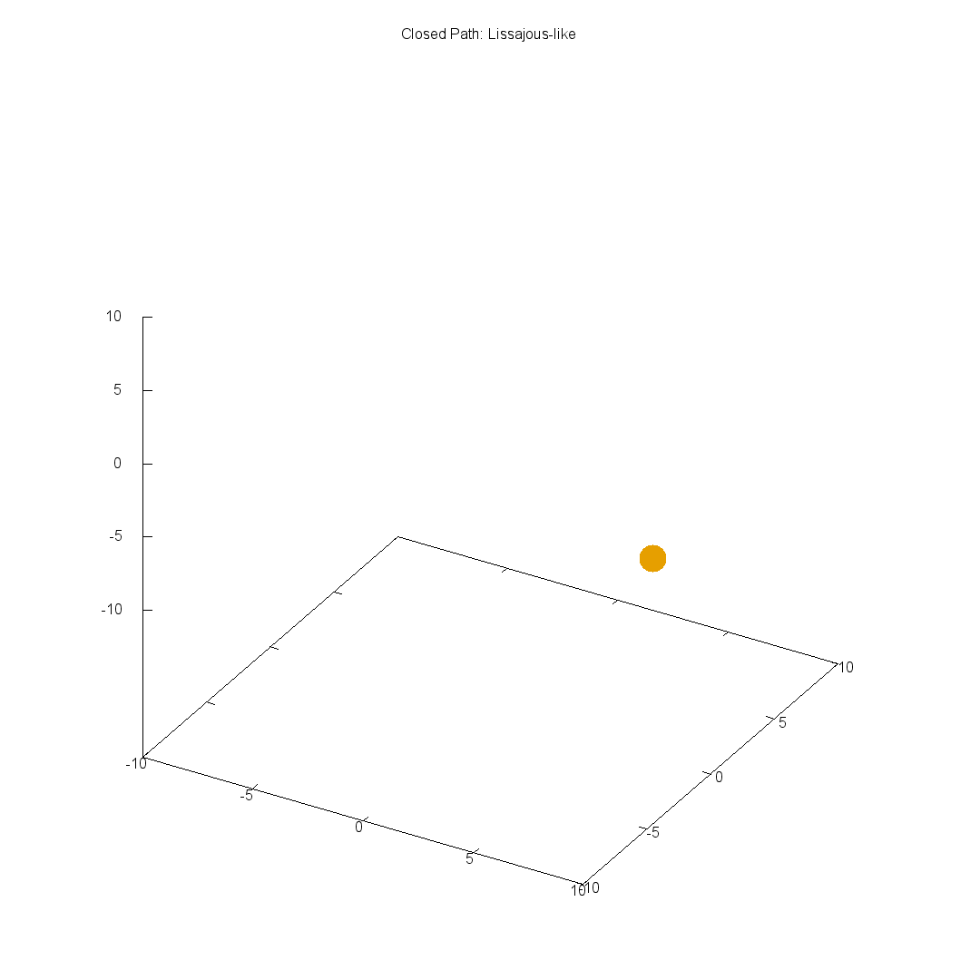
Closed paths
We obtained “Lissajous-like” paths that are closed. Not trivial to find.

Slide 35
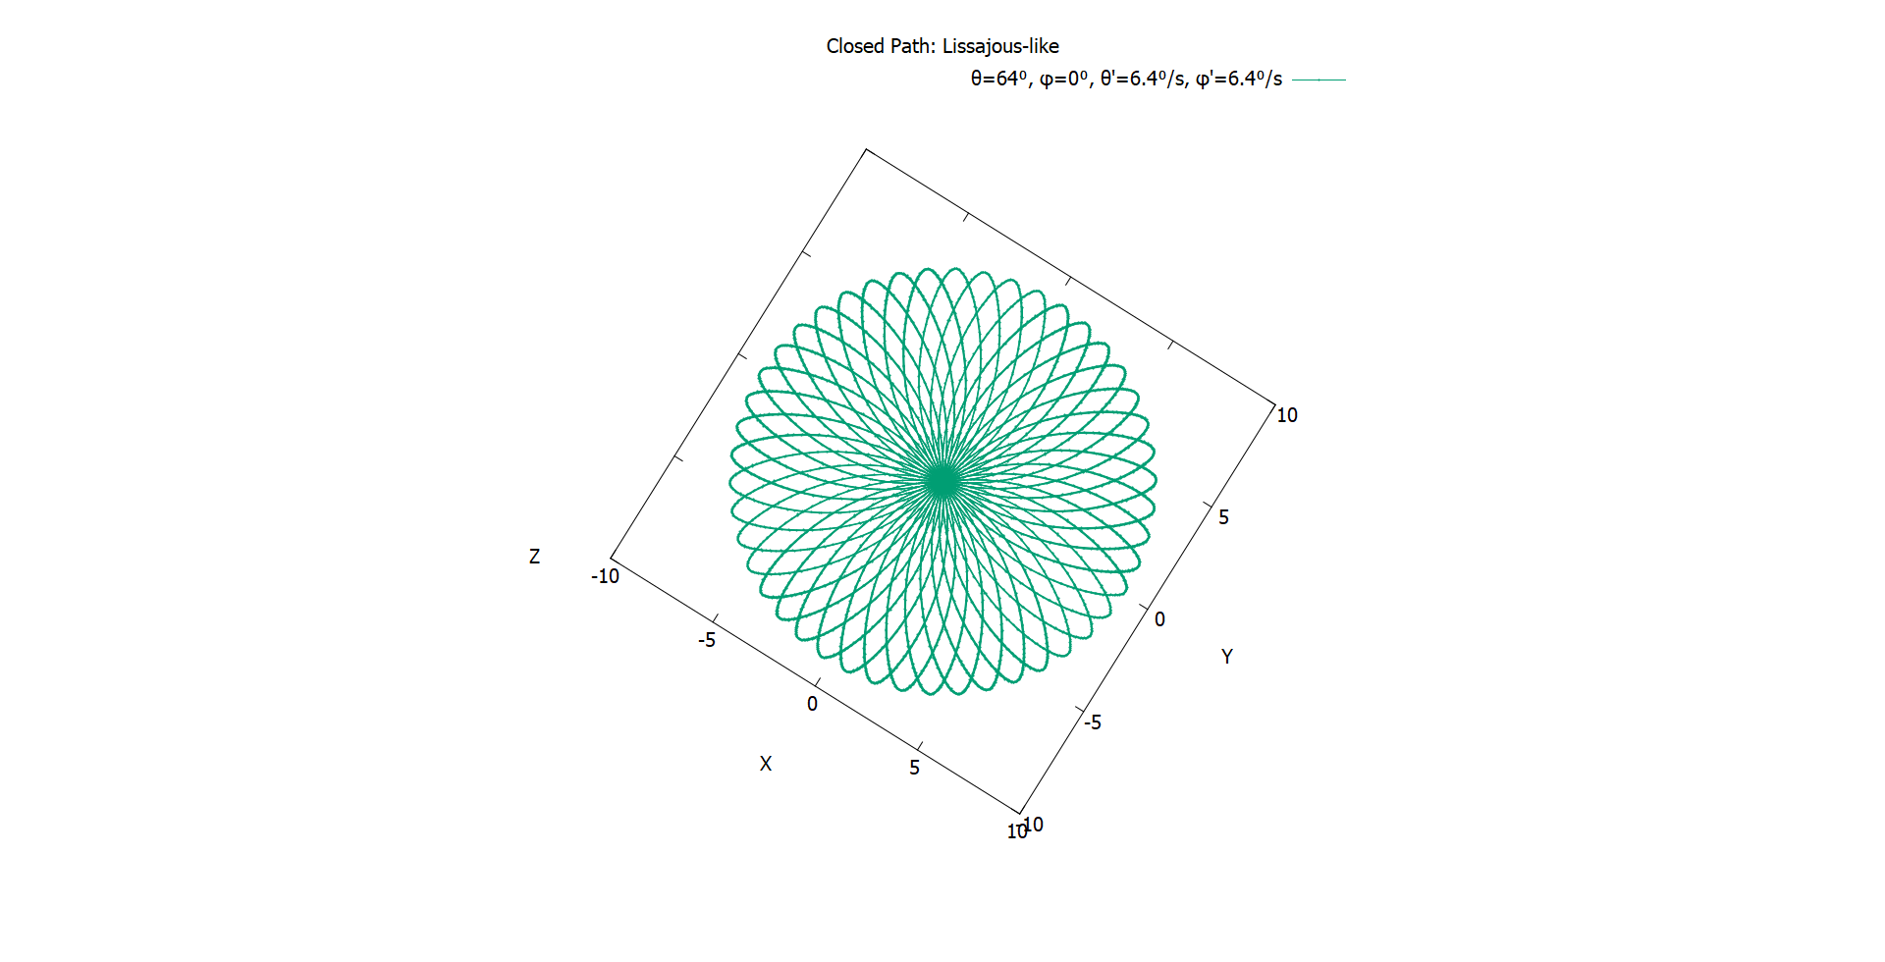
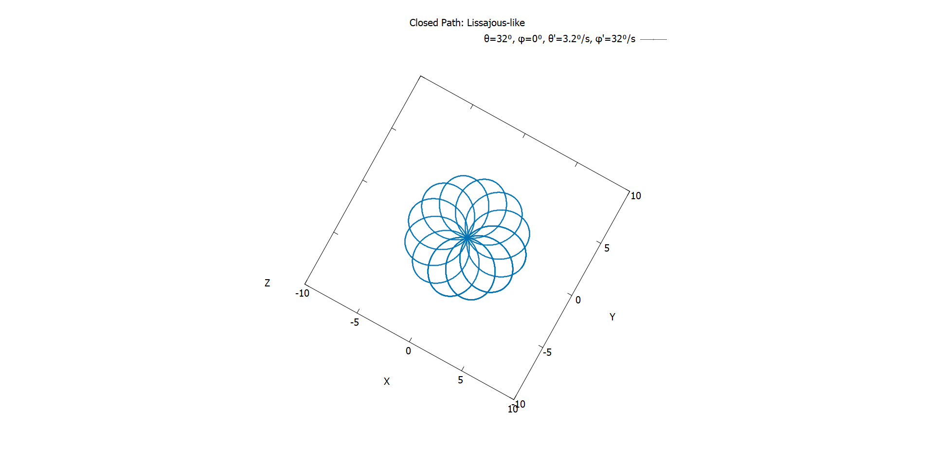
Closed paths
Here are some more of them. Pretty, aren’t they?

Slide 36
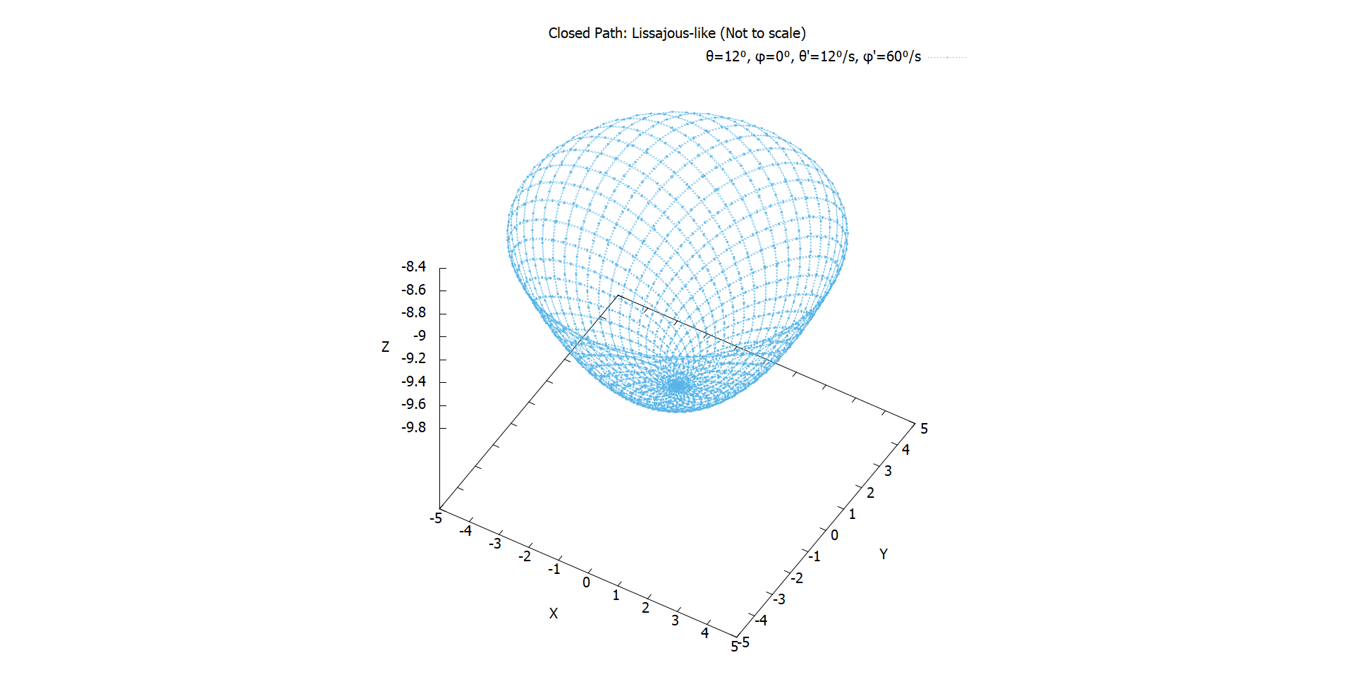
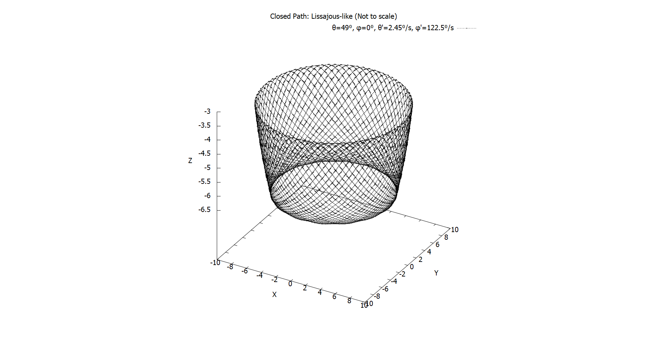
Closed paths
Some extra ones, in case you’re not yet satisfied.

Slide 37
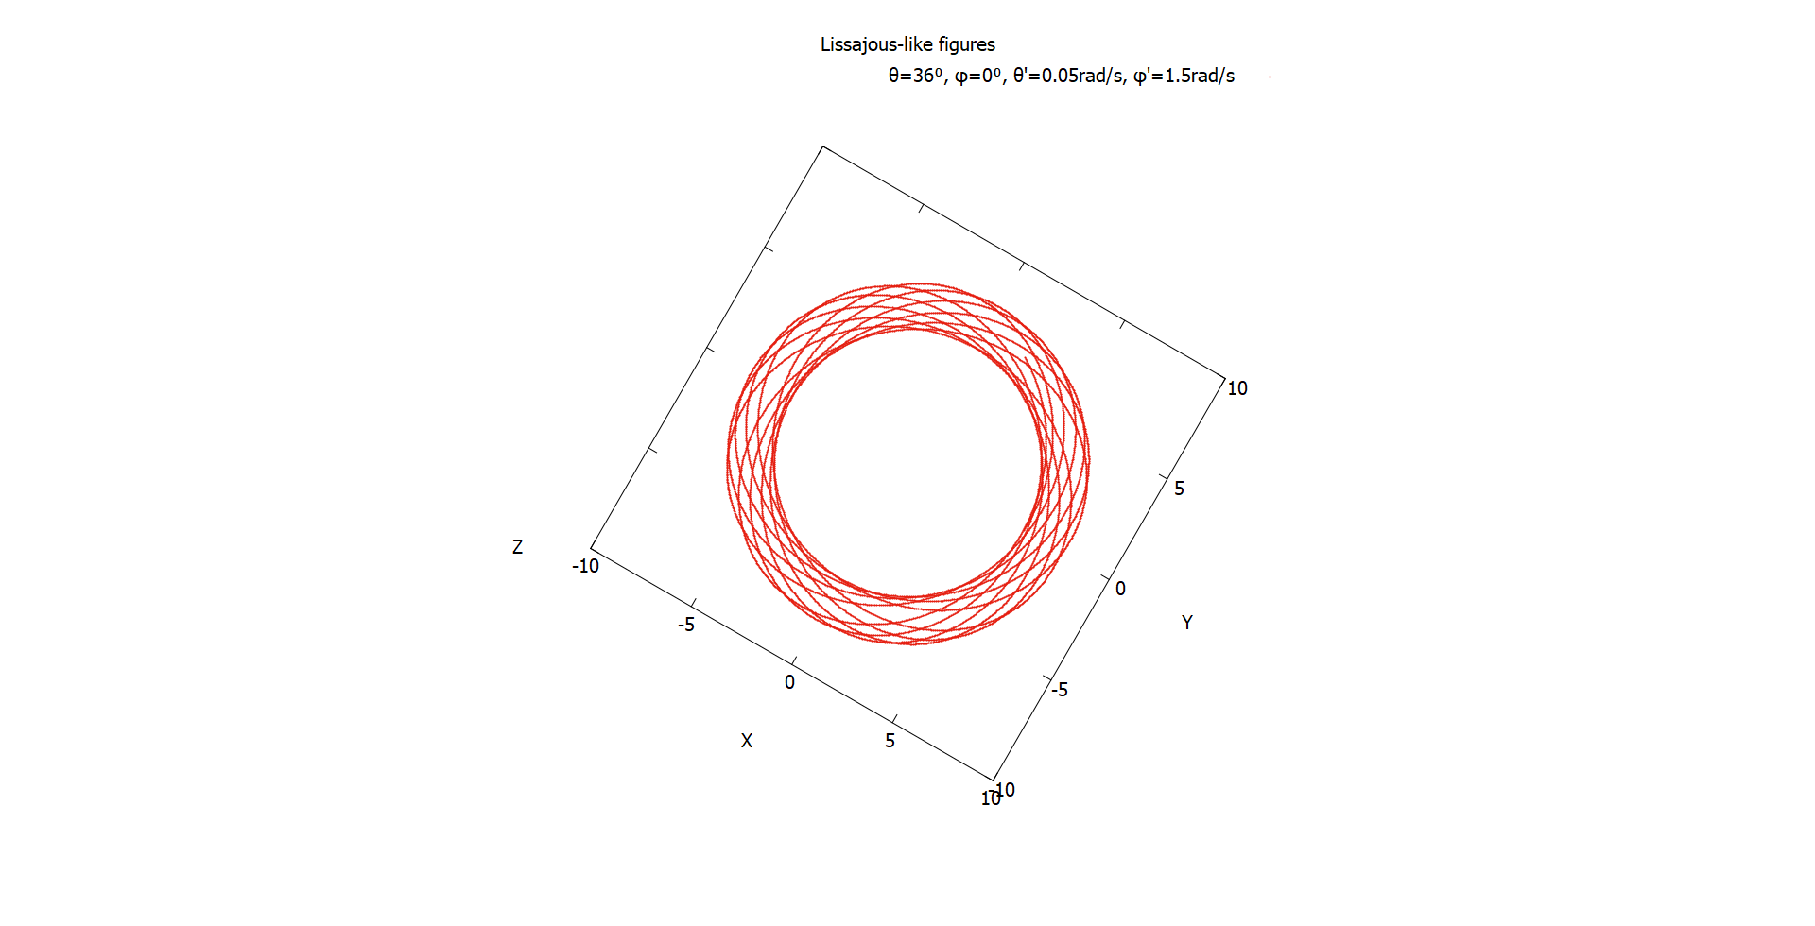
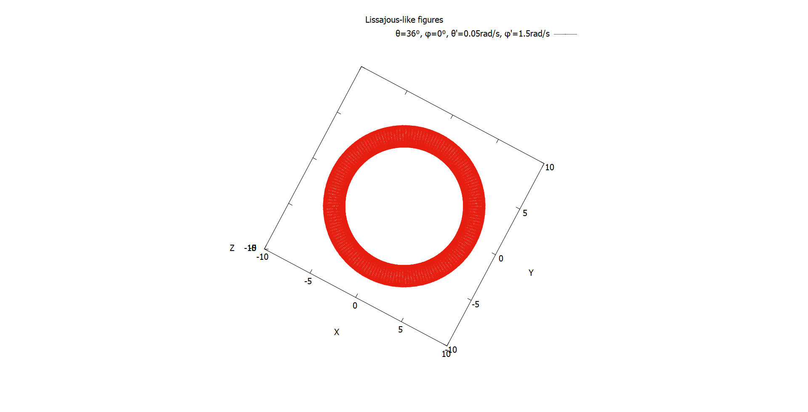
Lissajous-like figures
“Lissajous-like” figures aren’t always closed.

Slide 38
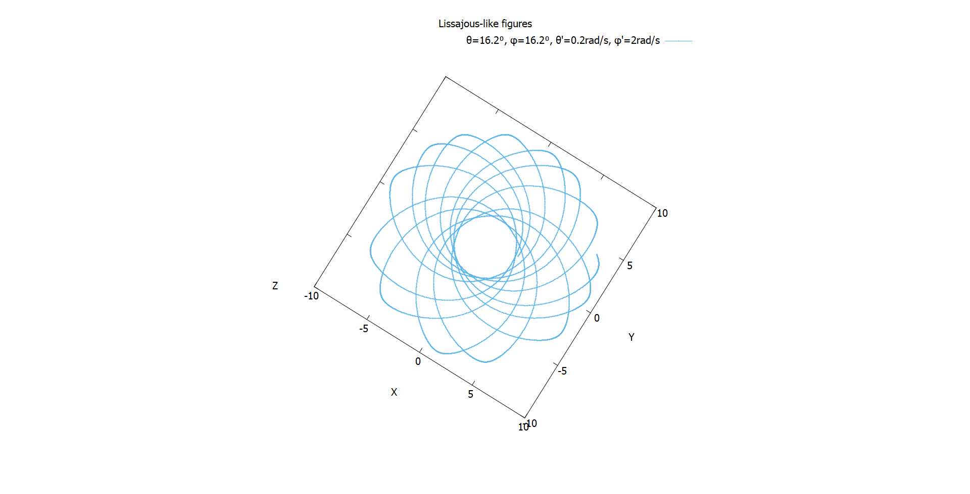
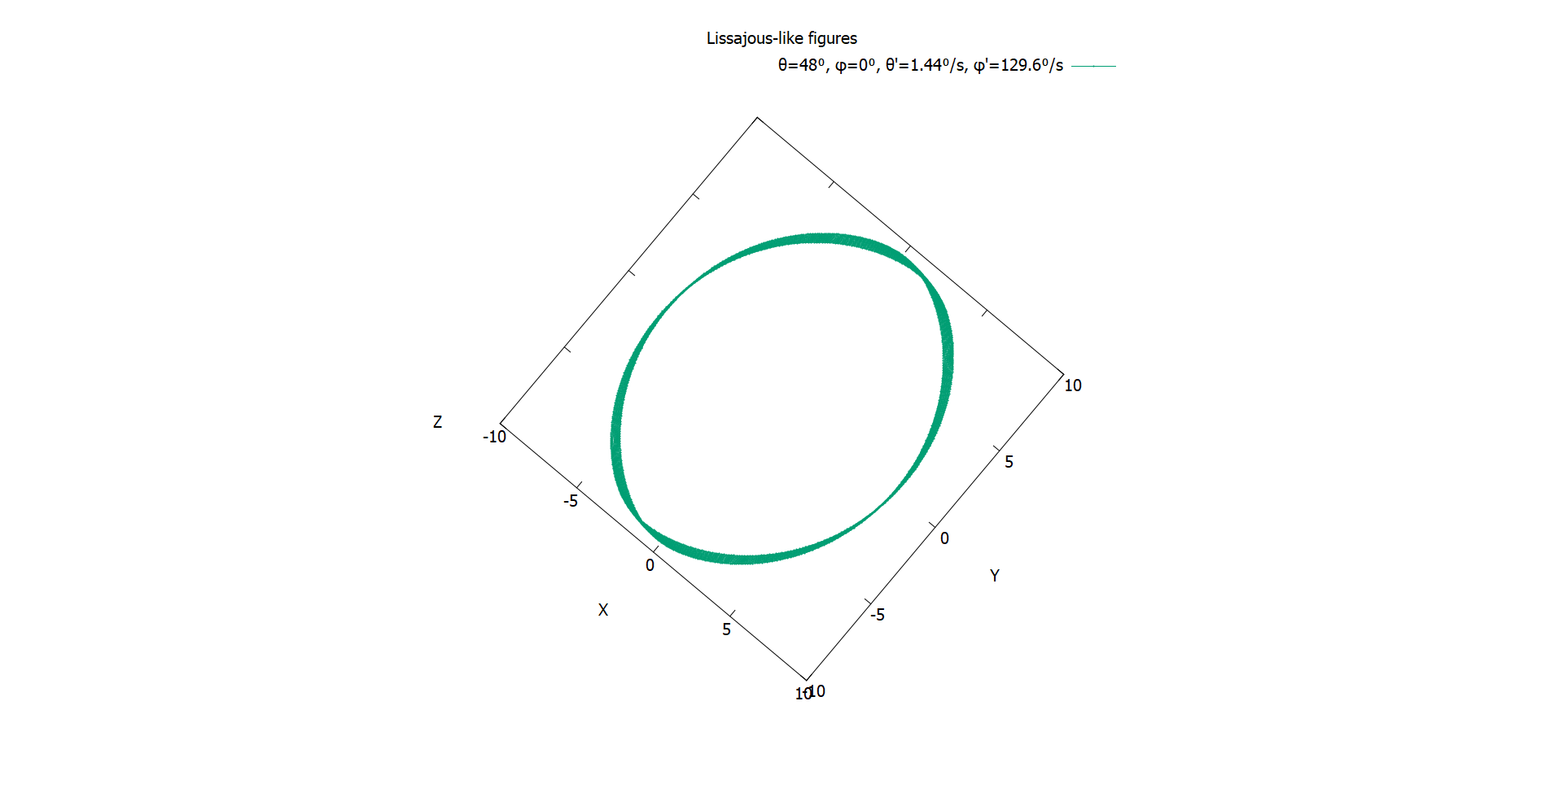
Lissajous-like figures
“Lissajous-like” figures is open to interpretations.

Slide 39
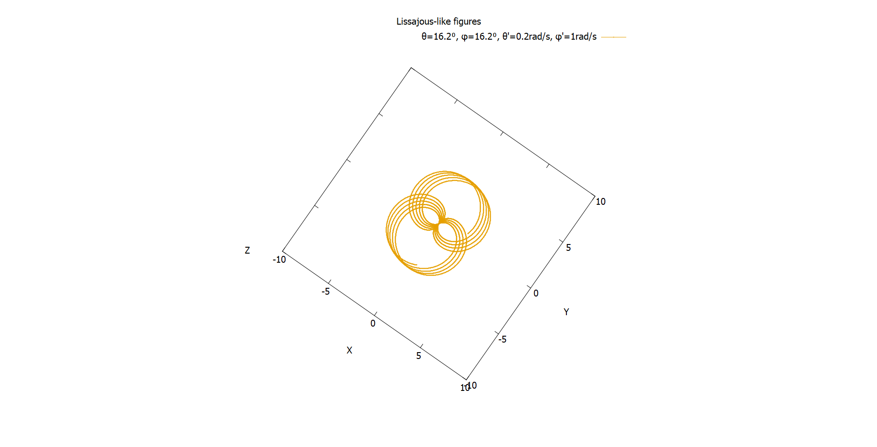
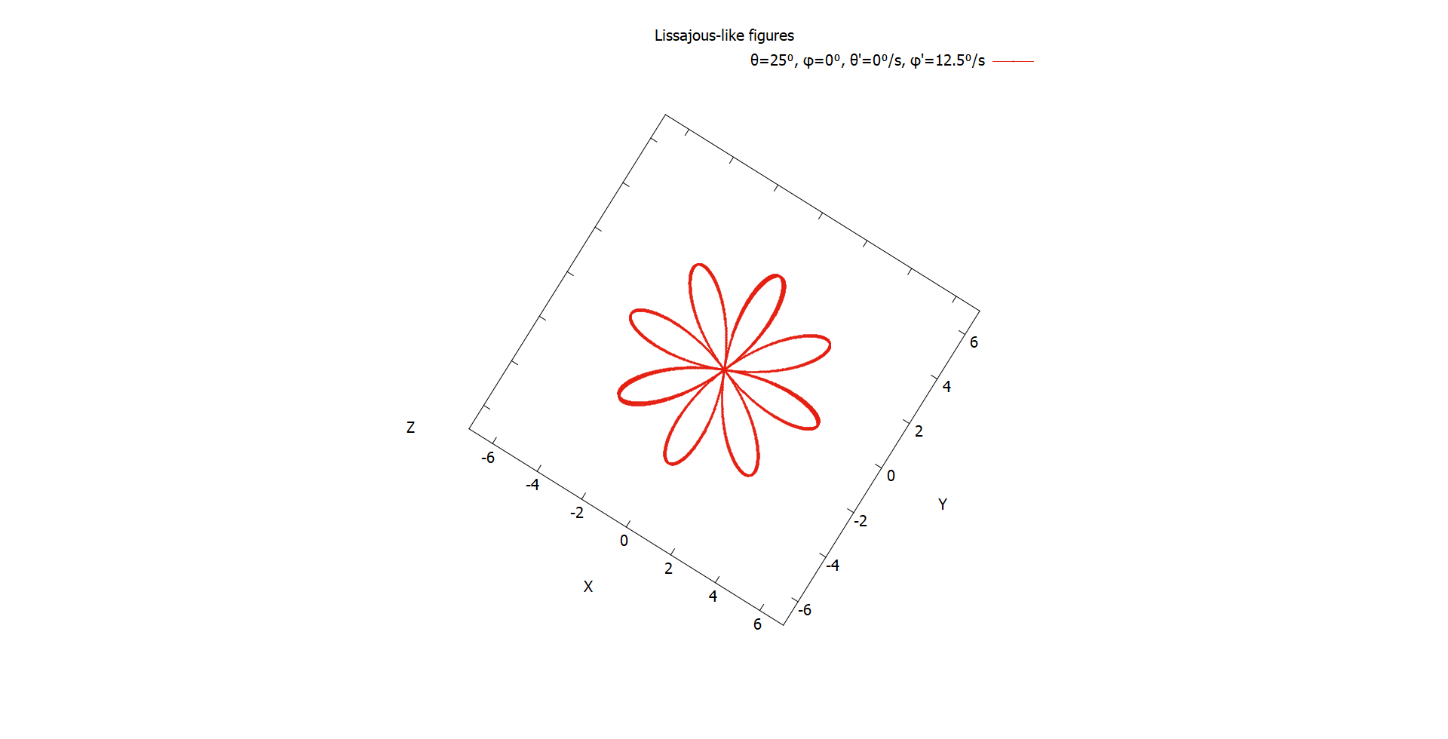
Lissajous-like figures
These are some of the figures we came up with.

Slide 40
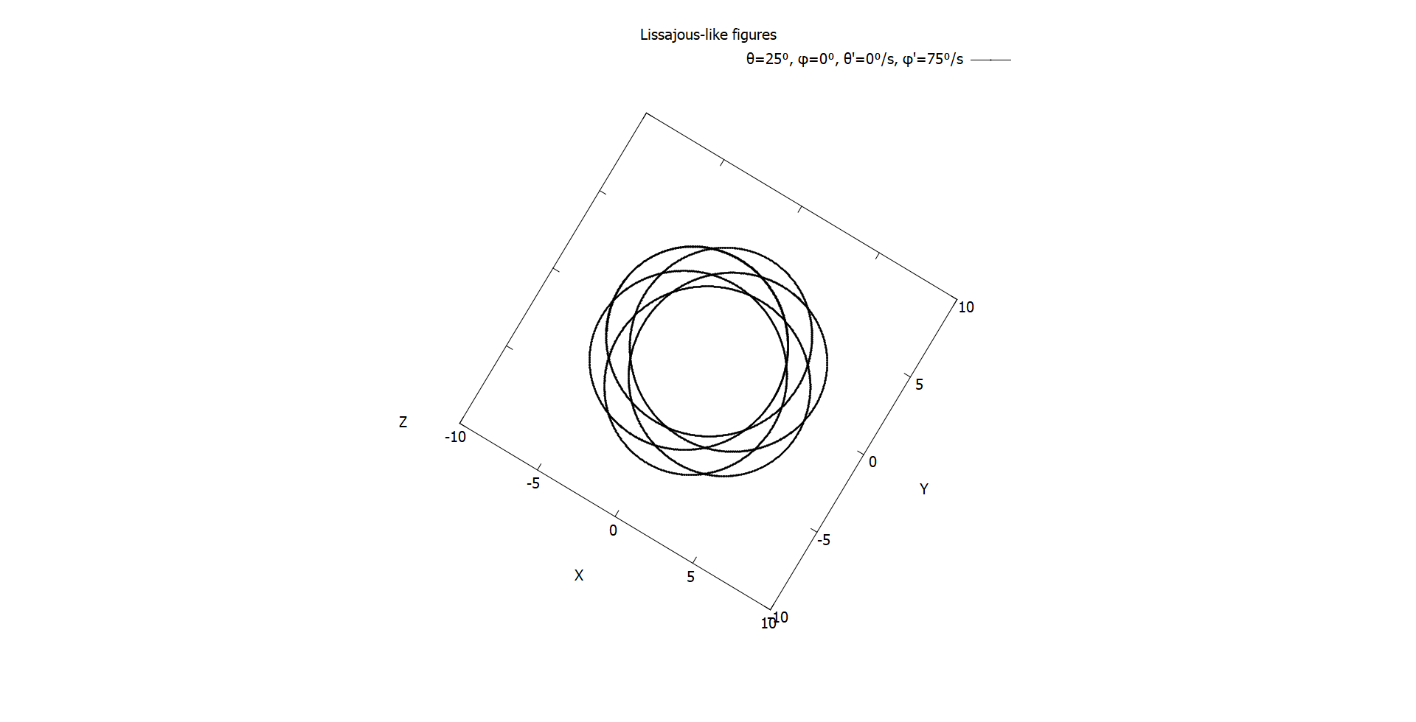

Lissajous-like figures
We can’t predict the shape from initial conditions.

Slide 41


Lissajous-like figures
But they’re pretty nevertheless.

Slide 42



Lissajous-like figures
Here are some moving ones for your enjoyment.

Slide 43


Adding damping effect
Adding damping gave us the expected over/under-damped behaviors.

Slide 44

Damping coefficients
Adding damping effect
As far as we increase the damping coefficient, the energy loss increase. That refers to that the damping on 2 degrees of freedom

Slide 45

Simple pendulum
Conservation of energy
The energy is almost constant with time.
Then energy is conserved.

Slide 46

Circular path
Conservation of energy
The energy is constant with time.
These steps due to machine precession.
Then energy is conserved.

Slide 47

Simple pendulum
Conservation of angular momentum
Angular momentum is constant at zero.
Which means it is conserved.

Slide 48

Circular path
Conservation of angular momentum
The angular is constant with time.
These steps due to machine precession.
Then angular momentum is conserved.

Slide 49

Arbitrary path
Conservation of energy
The total energy is oscillating, this is strange!
It should be conserved.

Slide 50

Arbitrary path
Conservation of energy
Investigating the two parts of total energy: Potential energy and kinetic energy.

Slide 51

Arbitrary path
Conservation of angular momentum
The angular momentum is oscillating, so can we say it is conserved?
The average value of it is constant.

Slide 52
So, are they conserved?
Yes, for motion restricted to a plane.
For the simple pendulum motion, the angular momentum is zero all the time, which means it conserved.

Slide 53


Out of the surface
Letting the ball goes out the hemisphere.

Slide 54


Out of the surface
Adding different damping coefficients to the game!

Slide 55

Summary
In part I, we investigated the motion on 1D surfaces, and it wasn’t as simple as circular surface (simple pendulum).
We studied the effects of damping and driving, and found some surprising behaviour.
We didn’t find any chaotic motion, but did find some ”period multiplied” paths in $C_{1}$.

Slide 56
Summary
In part II, with the spherical surface, we saw a more realistic motion with 2 degrees of freedom.
We investigated the initial conditions for different paths. We added damping, and considered motion on a hemisphere.
From all of these, constrained motion is quite interesting and not at all straightforward.

Slide 57
Work distribution
Ali | Coding part I and animations
Asif | Coding part I, plots and report
Kumail | Coding part II and presentation

